Slide 1
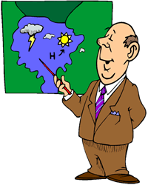
Meteorologist Activity
Activity Directions
Your weather team has been tasked with interpreting the following satellite images and make predictions about; front activities, cloud cover, temperatures and humidity, expected and real time precipitation, wind speed and direction. Use the appropriate weather map to answer the questions regarding weather conditions for specific major cities.
http://www.weather.com/maps/currentusweather

Slide 2
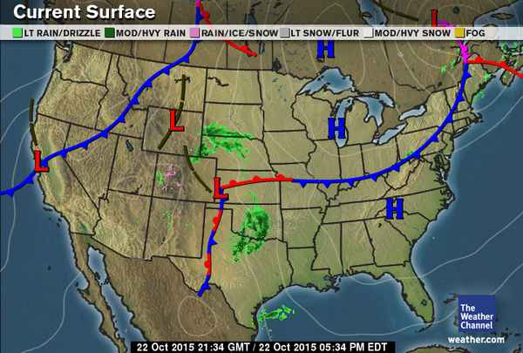
Weather Front and Pressure
*Seattle
Helena *
Fargo *
Boston*
*Salt Lake City
*Cleveland
*San Francisco
Kansas City
*
Louisville
*
*
Denver
*Las Vegas
*Nashville
*Los Angeles
Oklahoma
City *
*Charlotte
*Phoenix
*Dallas
*Odessa
New Orleans
*
Gulf of
Mexico
* Miami

Slide 3
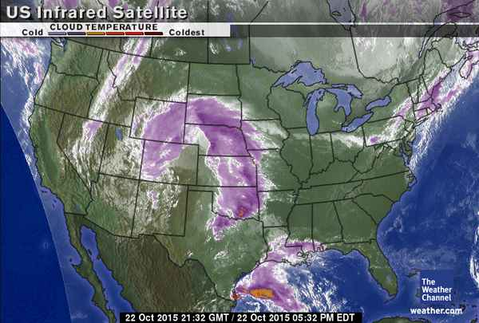
Cloud Cover
*Seattle
Helena *
Fargo *
Boston*
*Salt Lake City
*Cleveland
*San Francisco
Kansas City
*
Louisville
*
*
Denver
*Las Vegas
*Nashville
*Los Angeles
Oklahoma
City *
*Charlotte
*Phoenix
*Dallas
*Odessa
New Orleans
*
* Miami

Slide 4
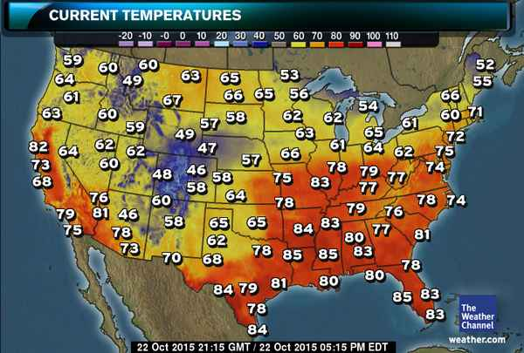
*Seattle
Helena *
Fargo *
Boston*
*Salt Lake City
*Cleveland
*San Francisco
Kansas City
*
Louisville
*
*
Denver
*Las Vegas
*Nashville
*Los Angeles
Oklahoma
City *
*Charlotte
*Phoenix
*Dallas
*Odessa
New Orleans
*
* Miami

Slide 5
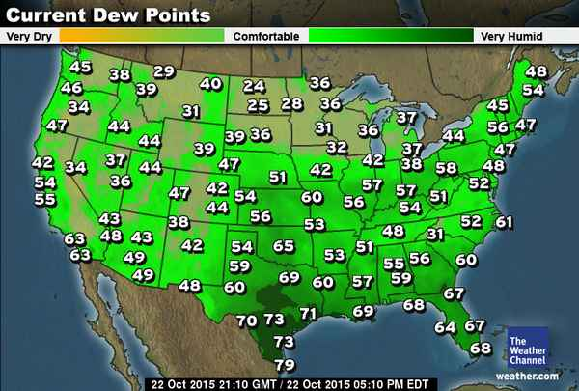
*Seattle
Helena *
Fargo *
Boston*
*Salt Lake City
*Cleveland
*San Francisco
Kansas City
*
Louisville
*
*
Denver
*Las Vegas
*Nashville
*Los Angeles
Oklahoma
City *
*Charlotte
*Phoenix
*Dallas
*Odessa
New Orleans
*
* Miami

Slide 6
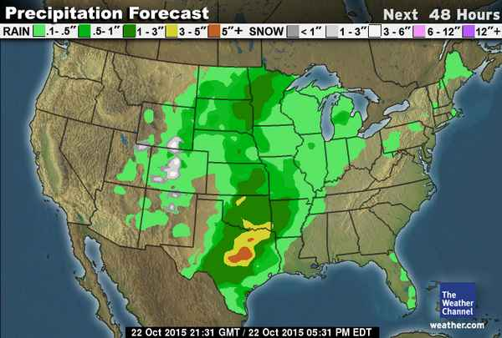
*Seattle
Helena *
Fargo *
Boston*
*Salt Lake City
*Cleveland
*San Francisco
Kansas City
*
Louisville
*
*
Denver
*Las Vegas
*Nashville
*Los Angeles
Oklahoma
City *
*Charlotte
*Phoenix
*Dallas
*Odessa
New Orleans
*
* Miami

Slide 7
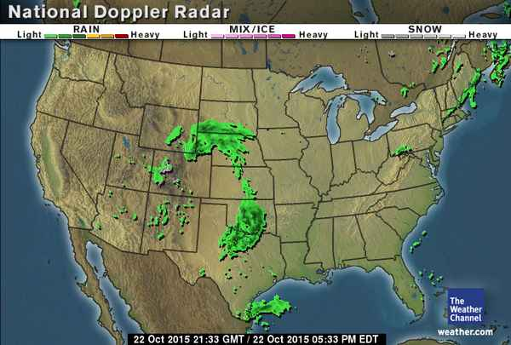
*Seattle
Helena *
Fargo *
Boston*
*Salt Lake City
*Cleveland
*San Francisco
Kansas City
*
Louisville
*
*
Denver
*Las Vegas
*Nashville
*Los Angeles
Oklahoma
City *
*Charlotte
*Phoenix
*Dallas
*Odessa
New Orleans
*
* Miami

Slide 8
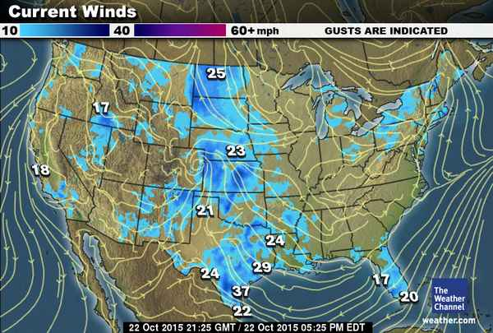
*Seattle
Helena *
Fargo *
Boston*
*Salt Lake City
*Cleveland
*San Francisco
Kansas City
*
Louisville
*
*
Denver
*Las Vegas
*Nashville
*Los Angeles
Oklahoma
City *
*Charlotte
*Phoenix
*Dallas
*Odessa
New Orleans
*
* Miami

Slide 9
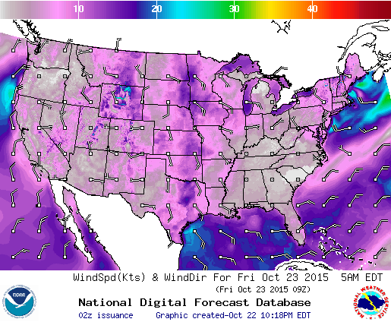
Key
*Seattle
Helena *
Fargo *
Boston*
*Salt Lake City
Kansas City*
*Cleveland
*San Francisco
Louisville
*
*
Denver
*Las Vegas
Oklahoma
City *
*Nashville
*Los Angeles
*Charlotte
*Phoenix
*Dallas
*Odessa
New Orleans
*
* Miami

