Slide 1
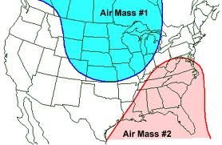
Air Masses 10/2/12

Slide 2
Weather changes as air masses move.
____________- large volume of air where temperature and humidity are the _________ at different altitudes.
Air masses can cover thousands of square miles
Air masses form when air sits over a region of Earth for many days.
The sitting air takes on the characteristics of the ________________________________. This means:
When the Earth’s surface gets cold, the air does too.
When the Earth’s surface is wet, the air becomes moist.

Slide 3
Characteristics of Air Masses
Air masses are categorized by the characteristics of the region where it formed.
The two categories are made of two words.
The first word describes the _____________ of the air mass.
The second word describes the _____________________.

Slide 4
2 word Category Names
First word tells whether mass was formed over dry land or water (_______________)
_______________________ air mass- forms over land and loses its moisture to the land below it, becoming dry.
____________________ air mass- forms over water and become moist as it gains water vapor from the water below it.

Slide 5
2 word category names
Second word tells whether an air mass is formed close to the equator (______________)
____________ air mass- forms near the equator and becomes warm by gaining energy from the warm land and water below it.
____________ air mass- forms far from the equator and becomes cool as it loses energy to the cold land and water below it.

Slide 6
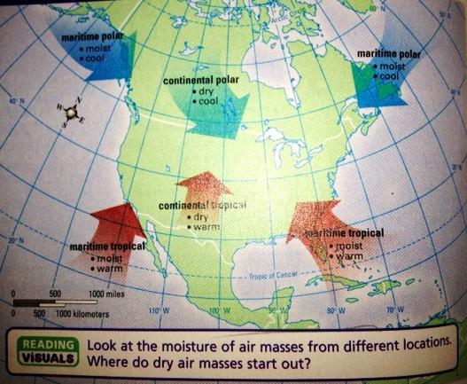
North American Air Masses
The combination of words gives characteristics of the air mass.

Slide 7
Movement of an Air Mass
Air masses travel away from the regions they were formed.
They move with the global wind patterns.
As air masses move, they take with them their characteristics.
As they travel over a surface with different characteristics, the _________________ changes the air mass.
This change can take days or weeks. If the air mass is moving fast enough, it can travel with its characteristics a great distance.

Slide 8
Weather changes where air masses meet.
A ____________ is a boundary between air masses.
The weather near a front can differ from the weather inside the air mass.
As one air mass pushes another, some of the air at the boundary will be pushed ______________. This creates clouds and can lead to cloudy and stormy weather as a front passes.
After the front passes you experience the characteristics (temperature and humidity) of the air mass.

Slide 9
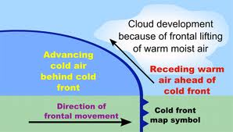
Cold Fronts
When a mass of ___________, dense air ___________ moves, pushing warm air upwards.
Tall cumulonimbus clouds are often produced. Brief/heavy storms leave behind cooler and clear weather.

Slide 10
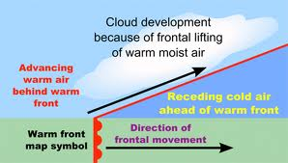
Warm Fronts
When a warm air mass ___________moves up and ____________ a mass of dense, cold air.
Moisture in the warm air condenses producing cloud-covered skies: first, high cirrus clouds, then high stratus clouds, and last, lower stratus clouds. Often bringing hours of steady rain or snow, leaving warmer air behind.

Slide 11
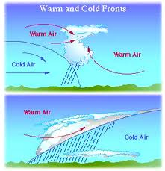

Slide 12
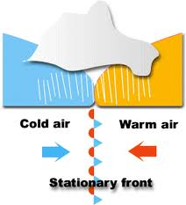
Stationary Fronts
When air masses first meet or when a front stops moving.
The air in each air mass can still move along the side or over the front.
This can produce cloud covered skies.
When the stationary front starts to move, it can become a warm or cold front depending upon which air mass advances or pushes the other.

Slide 13
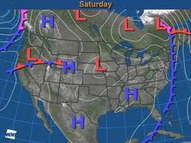
H stands for a high pressure area. It is the highest pressure area in a region.
L stands for a low pressure area. It is the lowest pressure area in a region.

Slide 14
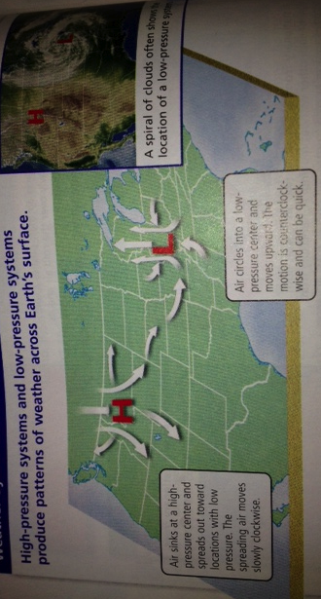
Pressure Systems
Pressure differences can cause air to move in ways that make a high or low pressure area the center of a whole system of weather.

Slide 15
How high and low pressure make air move.

Slide 16
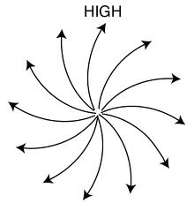
High-Pressure System
A small area of high pressure can develop into a larger system.
A high pressure system forms when air moves around a high-pressure center.
Air sinks slowly to warmer, lower altitudes. As the air nears the ground, it spreads outwards, toward areas of lower pressure.
Most high-pressure systems are large and change slowly. When it stays in the same location for a long time, an air mass may form.
High-pressure systems bring clear and calm weather.
Air moves down, out, and around!

Slide 17
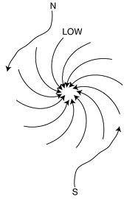
Low-Pressure System
A small area of low pressure can develop into a larger system.
A low-pressure system forms around a low pressure center.
Air moves quickly around and inwards, toward the lowest pressure center. Then, up to higher altitudes.
Often formed along the boundary of warm and cold air masses.
Part of the boundary between the masses moves south, forms a cold front.
Part of the boundary moves north and forms a warm front.
A center of low-pressure forms where the ends of the two fronts meet.
Can cause very stormy weather.
Air moves up, inward, and around.

