Slide 1
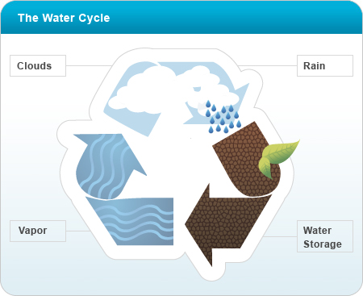
The Water Cycle and Cloud Formation

Slide 2
Water is ALWAYS in the atmosphere!
Earth’s water is mostly found in the oceans, but it is also found in lakes, rivers, ice sheets, in plants, and underground.
It can be present as a solid (like snow), liquid (rain), or gas (water vapor).
Water changes its form when temperature changes.
It is RECYCLED! Oceans hold most of our water.
Earth’s water goes through never-ending cycle of evaporation, precipitation, and condensation.

Slide 3
The Water Cycle
Evaporation- Liquid changes to gas.
  It needs energy to go from liquid to gas!
  Energy from sun causes molecules to evaporate from the surface of a body of water. These molecules become part of the air as water vapor.
Condensation- Gas changes to liquid.
  Occurs when moist air cools. (As the water vapor rises higher into the atmosphere, it cools.)
  The loss of heat causes the water vapor to condense into tiny water droplets or ice crystals.
Precipitation- Liquid or solid water falling to Earth’s surface.
  When the droplets/ice crystals get heavy enough, they fall as rain, slow, sleet, or hail.

Slide 4
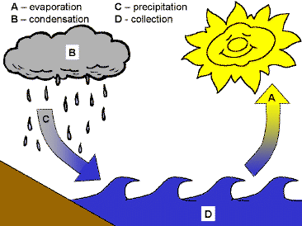

Slide 5
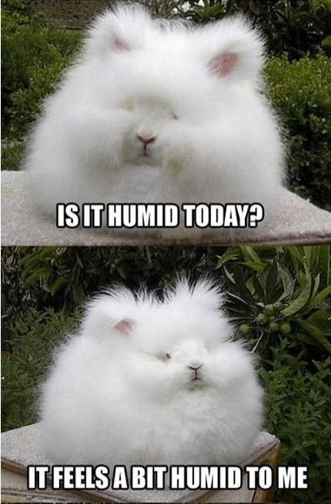

Slide 6
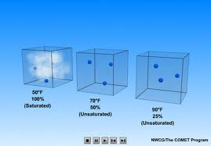
Humidity & Saturation
Humidity- the amount of water vapor in the air.
Saturation- 100% relative humidity.
Air is unsaturated when more water evaporates than condenses.
When air becomes saturated, equal amounts of water evaporate and condense.
The warmer the air is, the more water it takes to saturate it.

Slide 7
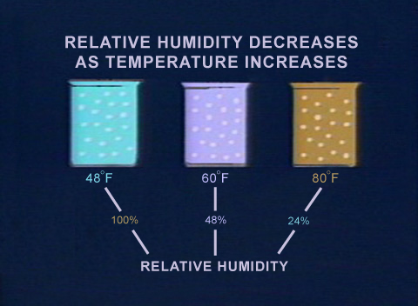
Relative Humidity
Relative Humidity- Compares the amount of water in the air to the maximum amount of water that can be present at that current temperature.
Ex: Air with 50%
relative humidity
has half the amount
of water needed
for saturation.

Slide 8
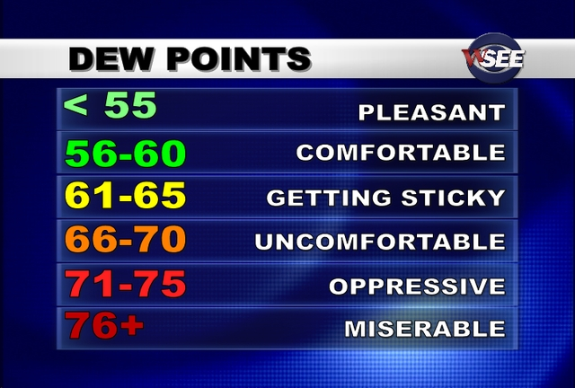
Dew Point
Dew Point- The temperature at which air reaches saturation.
As dew point increases, humidity increases.
Ex: Air with a dew point of 79⁰F will become saturated if it cools to 79⁰F
http://www.youtube.com/watch?v=S8W-xl4mcJ8

Slide 9
HOW does water condense?
Clouds are CONDENSED water vapor.
As warm air rises, it cools. When it cools to dew point, water vapor condenses into droplets.
WATER MUST CONDENSE ON SOMETHING SOLID!!!
There are no large surfaces floating around in the air.
BUT the air is full of tiny particles of dust, smoke, and salt from the ocean.
Water vapor condenses to these solid particles.

Slide 10
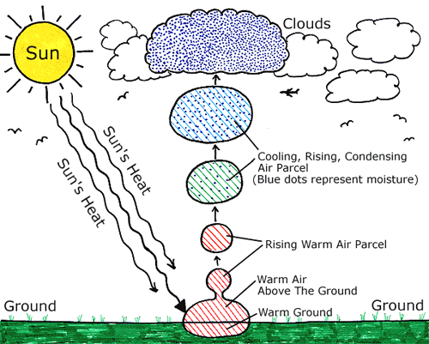

Slide 11
Classification of Clouds
Clouds are classified and named according to their altitudes, the way they are formed, and their general characteristics.
Composition of clouds = determined by location.
  As altitude increases, temperature decreases, right?
  So clouds at high altitudes are made of ice crystals
Three main types:
  Cirrus
  Cumulus
  Stratus

Slide 12
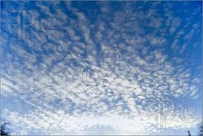

Cirrus Clouds
Form in very cold air at high altitudes
Made of ice crystals, have a wispy, feathery appearance
Strong winds often blow tails/streamers and shows direction of wind
Often seen in fair weather, occasionally warning sign of storm approaching.

Slide 13
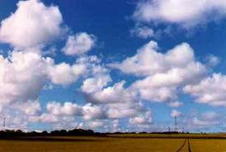
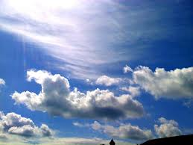
Cumulus Clouds
Puffy and white with darker bases (cotton balls!)
Usually appear in the daytime in fair weather
If they grow taller they can produce showers (brief because they are spaced out).
Tallest- cumulonimbus- thunderheads (up to 11 miles tall)- drop heavy rainfall!

Slide 14
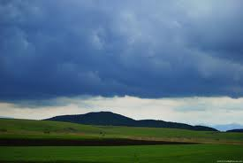
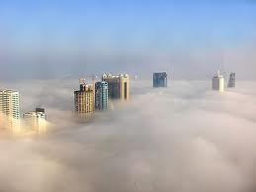
Stratus Clouds and Fog
Stratus- smooth layers because they form without strong air movement.
Produce steady, light precipitation
Usually very dark…can be so dark they completely block out the sun!
Fog- cloud that rests on the ground or body of water.
Forms when surface is colder than air.
Tends to be heaviest at dawn. Clears as ground is heated by sunlight.

Slide 15
Types of Precipitation
Rain- the most common form of precipitation. Forms from water droplets or ice crystals that melt as they fall.
Freezing rain- when rain drops freeze when the hit the ground or other cold surfaces. (Covers surfaces with ice)
Sleet- when rain passes through a layer of cold air, able to freeze before it hits the ground.
Snow- when ice crystals join together in the clouds and fall through freezing air.
Hail- lumps or balls of ice (form from cumulonimbus clouds), common in warm weather. They form from a process of falling and being pushed back up into the atmosphere. The more this is repeated, the larger the chunks are. The largest on record weighed 1.7 pounds!

Slide 16
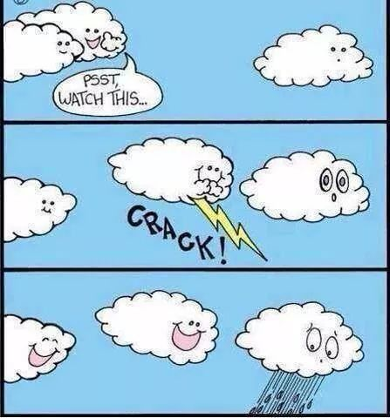

Slide 17
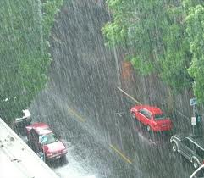
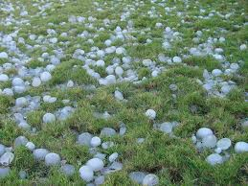
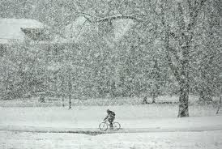
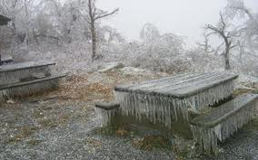

Slide 18
Precipitation can carry pollution!
Rain is naturally acidic.
Acid rain is rain that is more acidic than usual due to pollution.
Wind can blow pollution far away from its source.
Factories, power plants and automobiles release sulfur dioxide and nitrogen oxides into the air.
The gases combine with water vapor and become sulfuric acid and nitric acid.
This acid mixes with clouds and eventually falls to earth in a form of precipitation.
Acid rain harms trees and raises acidity of lakes, making it difficult for fish and other organisms to thrive. It also damages the surfaces of buildings.

Slide 19
