Slide 1
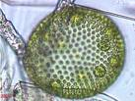


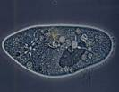
PROTISTS 4+
EUGLENA, AMOEBA, PARAMECIUM, VOLVOX
Notes:
]\

Slide 2

What is a protist?
Use your Guided Notes handout with this slideshow.
Protist—an organism from the Kingdom Protista
Very diverse group of single-celled organisms.
Eukaryotic (They have nuclei.)
`

Slide 3
Common Protists
Draw the table. Use a full page. 5 columns, 5 rows.
Protist Name | Sketch | Movement | Food source (Energy) | Special Features
Euglena
Amoeba
Paramecium
Volvox

Slide 4
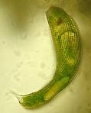
EUGLENA
Single-celled Protists= that lives in fresh water.
Captures food by eating other organisms
Has chlorophyll
`

Slide 5
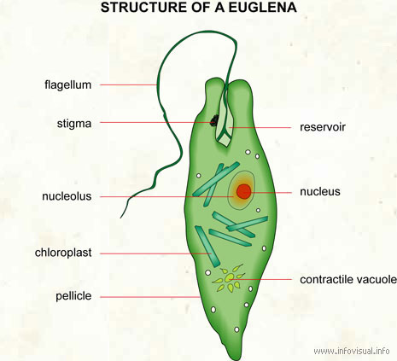

Slide 6
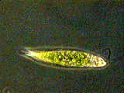
More Info on Euglena
Eyespot helps it sense light.
Waste- Contractile vacuole collects excess water then squirts it out of the cell.
Movement by a flagella
Video and Video
`

Slide 7
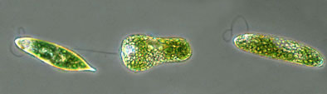
More Info on Euglenas
Reproduction- -asexual (binary fission)
Special features- shape changes easily so it can move around
`

Slide 8
AMOEBA
Found in freshwater and salt water around a lot of dead and decaying material.
Hunter
Can be parasite in humans
`

Slide 9
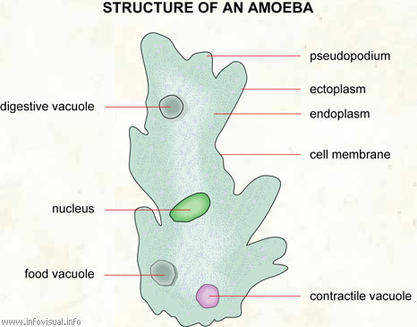

Slide 10
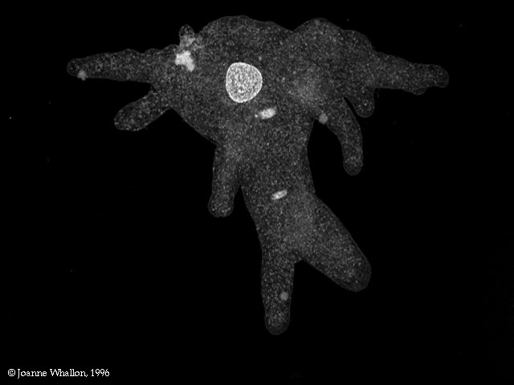
More Info on Amoebas
Waste- Contractile vacuole squirts out excess water
Movement- The cell shapes itself into pseudopods (false feet)
  made by cytoplasmic streaming
amoeba video
amoeba video

Slide 11
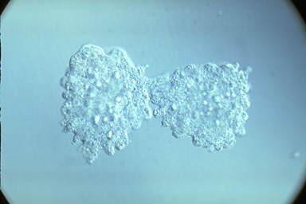
Amoeba
Reproduction- - asexual (binary fission)`

Slide 12

PARAMECIUM
Found in freshwater.
This is a complex single-celled organism.
Cilia sweep food into food passageway.
VIDEO
VIDEO
`

Slide 13
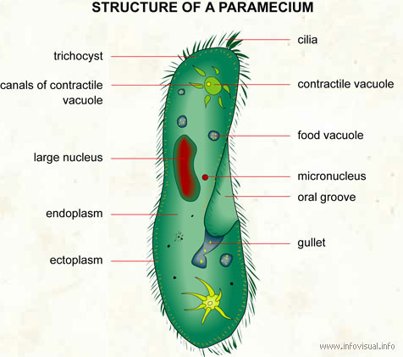

Slide 14
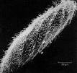
Paramecium Continued…
Waste-
  Anal Pore (food waste is removed)
  Contractile Vacuole (water waste removed)
Movement- cilia (tiny hairs that move back and forth.)
  Cilia also sweep food into the oral groove and gullet`
Notice the cilia covering my entire body!

Slide 15
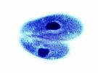
Paramecium Continued…
Reproduction- sexual (two parents)
Special feature- two nuclei (macronucleus and micronucleus)
`

Slide 16
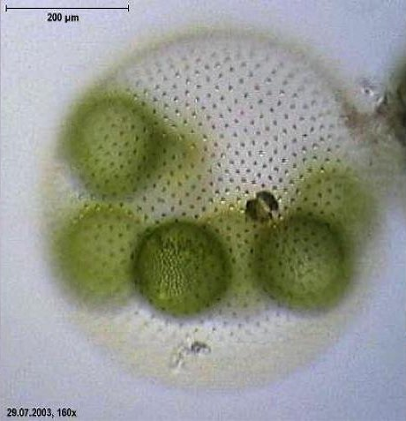
VOLVOX
Found in ponds ditches and puddles.
Composed of a colony of more than 50,000 tiny cells
Often called algae.
`

Slide 17
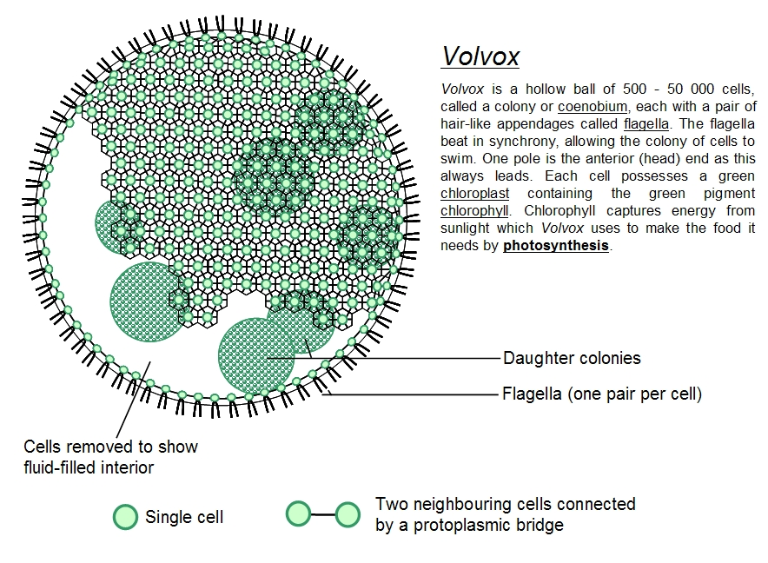

Slide 18
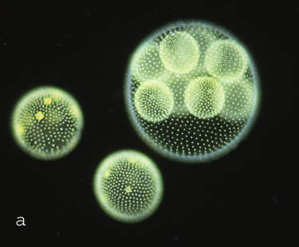
Volvox continued…
photosynthesis and flagella help bring in nutrients.
Eyespots sense light.
`

Slide 19
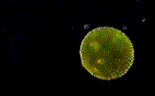
Volvox continued…
Movement- Many flagella help move the colony.
Reproduction- asexual and sexual, daughter colonies created.`

Slide 20

Volvox Videos
Watch them revolve.
video 1
video 2

Slide 21
Protists Groups and Features
Draw Table below on Page ?
Common Protists
Protist | Sketch | Movement | Food source (Energy) | Special Features
Euglena
Amoeba
Paramecium
Volvox

Slide 22
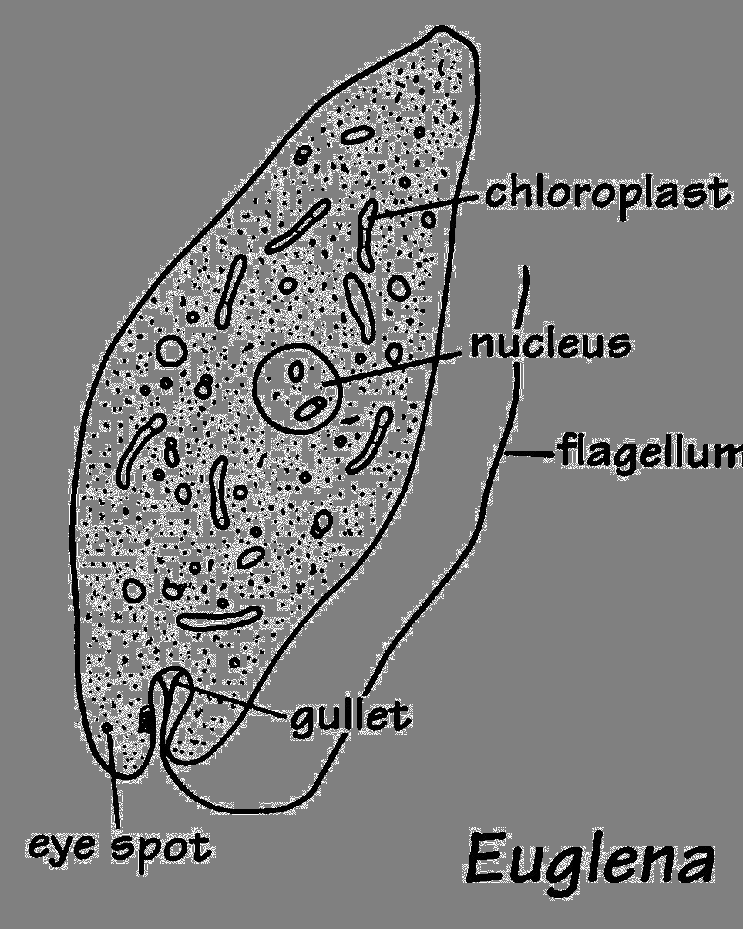
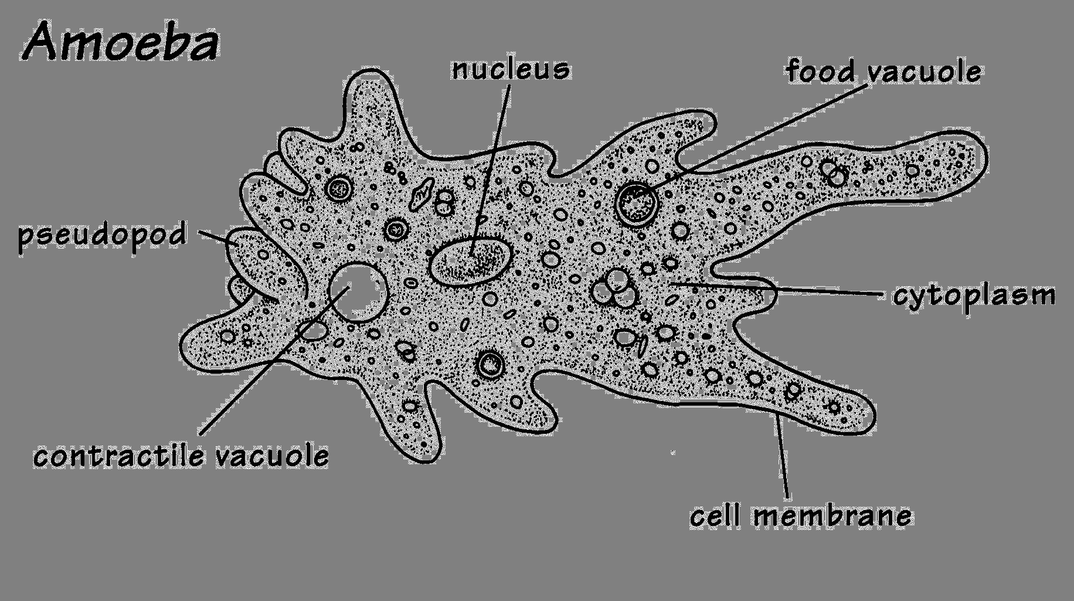
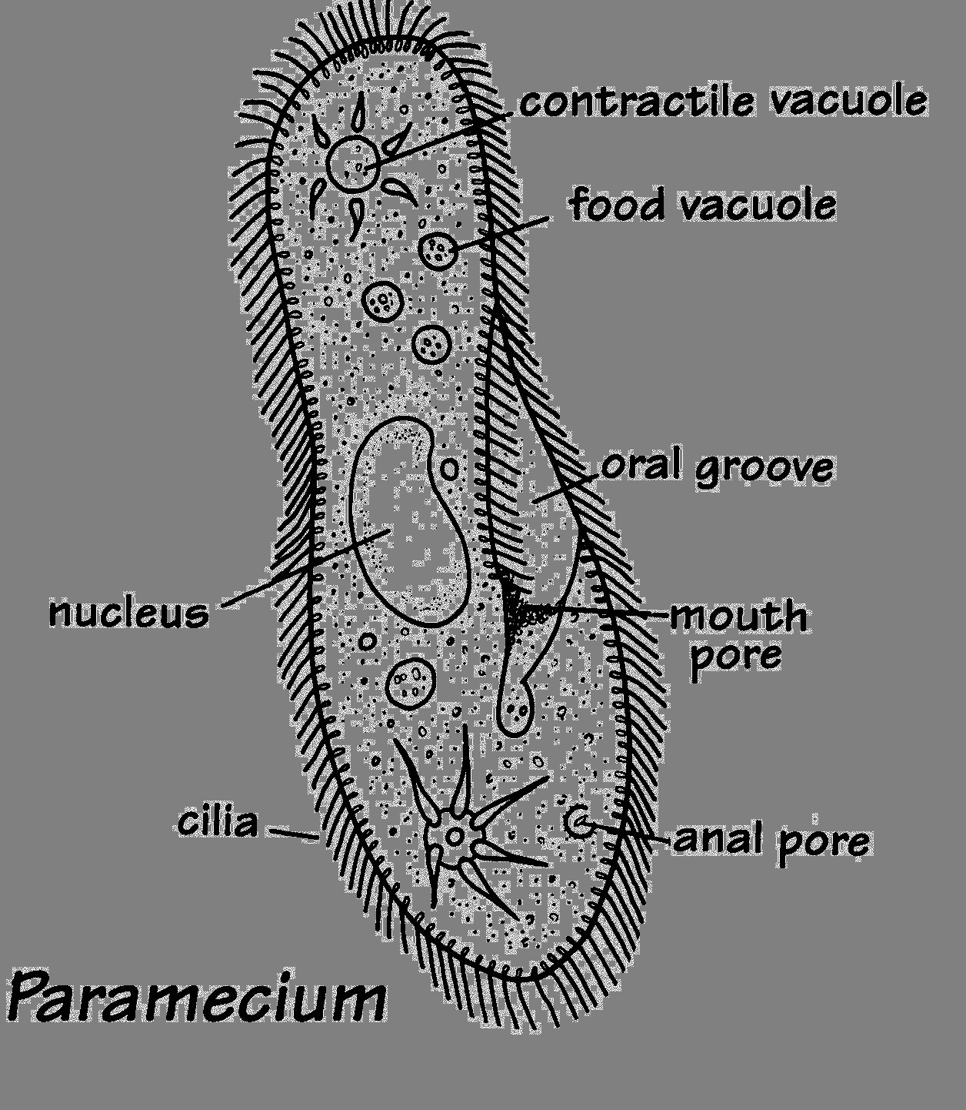
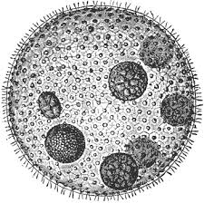
Protists Groups and Features
Common Protists
Protist | Sketch | Movement | Food source (Energy) | Specialized Features
Euglena | Unicellular | Flagellum | Feeds on other organisms; Also makes its own food by photosynthesis | Eyespot
Amoeba | Unicellular | Pseudopods | Feeds on other organisms
Paramecium | Unicellular | Cilia | Feeds on other organisms | Oral groove and contractile vacuole
Volvox | Lives in colonies | Flagella | Makes its own food by photosynthesis

Slide 23
Volvox

Slide 24
The Red Section
Recap / review
Other than this slide, please write down anything that is in RED.
`

Slide 25
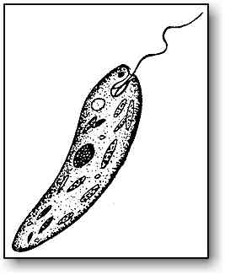
Euglena
Moves by a flagellum
eye spot
Contains chloroplasts
Common in fresh water
No cell wall so it can change shape.`

Slide 26
Euglena
Found in calm fresh and
  salt water
Used as a model organism in the lab
Autotroph – gets energy via photosynthesis
Heterotroph —also gets nourishment heterotrophically like animals
Has features of both plants and animals
Kingdom Protista`

Slide 27
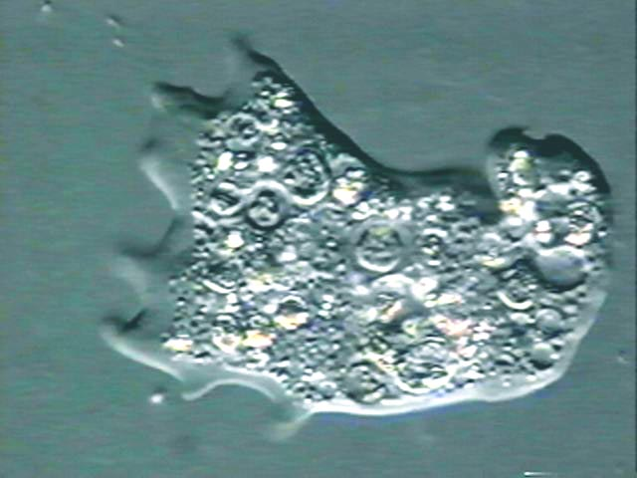
Amoeba
Moves by cytoplasmic streaming
Surrounds food and engulfs it using pseudopods. The food is then stored and digested in vacuoles.`

Slide 28
Amoeba
Changes shape drastically
Heterotrophic
Eats bacteria, algae, and other protists
Reproduces asexually
Can become dormant (cysts)
Can survive forcible division`

Slide 29
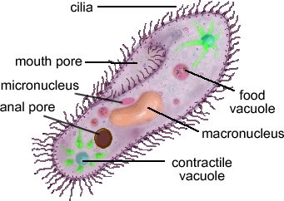
Paramecium
Most complex and specialized of the protists
Moves by cilia (hair-like projections)`

Slide 30
Paramecium
Fast--Can move about 12 body lengths per second
Shape of a pill capsule
Heterotrophic
Relatively large
Common in pond scum and freshwater
Has two nuclei (macro and micro)`

Slide 31
Paramecium
Uses cilia to sweep food into the oral groove
Feeds on micro-organisms like bacteria, algae, and yeasts
Is covered in cilia so it spirals through water`

Slide 32
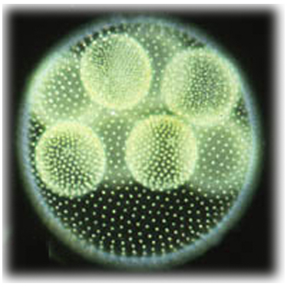
Volvox
A spherical colony of up to 50,000 cells
Contains chloroplasts
The colony revolves
Moves and acts as one multicellular organism
  but one cell can survive independent of the colony`

Slide 33
Volvox
Type of green algae
freshwater – ponds, ditches, puddles, lagoons
Colonies use flagella to swim
Cells have eyespots
Makes food by photosynthesis
    End of red section`

Slide 34
Quiz
Be sure you have the correct answers in your guided notes!!!

Slide 35
Which unicellular organisms move by flagella?
A. Euglena
B. Amoeba
C. Paramecium
D. Volvox
Euglena and Volvox

Slide 36
Which unicellular organism moves by cilia (hair-like projections)?
A. Euglena
B. Amoeba
C. Paramecium
D. Volvox
Paramecium

Slide 37
Which single-celled organism uses pseudopods to surround and engulf food?
A. Euglena
B. Amoeba
C. Paramecium
D. Volvox
Amoeba

Slide 38
Which organism is a colony of flagellates with chlorophyll?
A. Euglena
B. Amoeba
C. Paramecium
D. Volvox
Volvox

Slide 39
Which single-celled organism has an eye spot?
A. Euglena
B. Amoeba
C. Paramecium
D. Volvox
Euglena

Slide 40
Which colonial organism has eye spots?
A. Euglena
B. Amoeba
C. Paramecium
D. Volvox
Volvox

Slide 41
Which single-celled organism moves by cytoplasmic streaming?
A. Euglena
B. Amoeba
C. Paramecium
D. Volvox
Amoeba

Slide 42
Which organisms can have chlorophyll?
A. Euglena and Amoeba
B. Amoeba and Paramecium
C. Paramecium and Volvox
D. Euglena and Volvox
        Euglena and Volvox

Slide 43
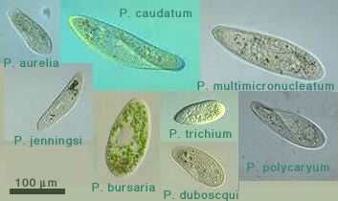
Which organism appears in all the photos in this slide?
paramecium

Slide 44
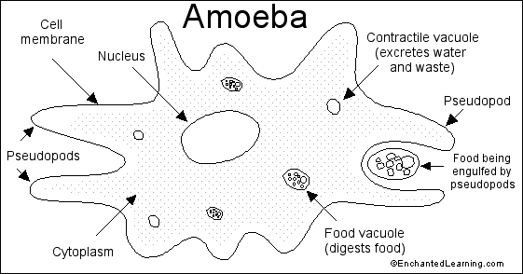
Read the diagram.
Be able to answer the questions on the following slide!

Slide 45
What engulfs the food?
cytoplasm
B. pseudopods
C. vacuoles
D. nucleus
pseudopods
What digests the food?
cytoplasm
B. pseudopods
C. vacuoles
D. nucleus
vacuoles

Slide 46
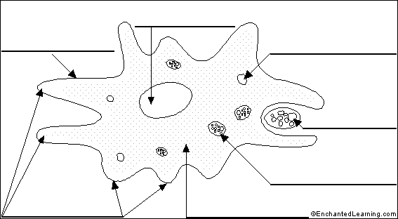
Name the parts located at A and B.
A
nucleus
B
cytoplasm

Slide 47
The End
Really.

