Slide 1
Protists
Euglena
Movement: Flagellum (whip-like structure) propels it forward
Food: Autotroph – photosynthesis through eye spot
Reproduction: Asexually
Amoeba
Movement: Oozing- cytoplasmic streaming with pseudopods (false feet)
Food: Heterotrophic- engulfs food by oozing
Reproduction: - asexually
Paramecium
Movement: Cilia moving back and forth
Food: Heterotrophic – using oral groove to pass food through contractile vacuole
Reproduction: Asexually
Volvox
Lives in Colonies
Movement: Flagellum (whip-like structure) propels it forward
Food: Autotrophic photosynthesis
Reproduction: Asexually and Sexually

Slide 2
What makes a protist animal like or plant like?
Paramecium
Volvox

Slide 3
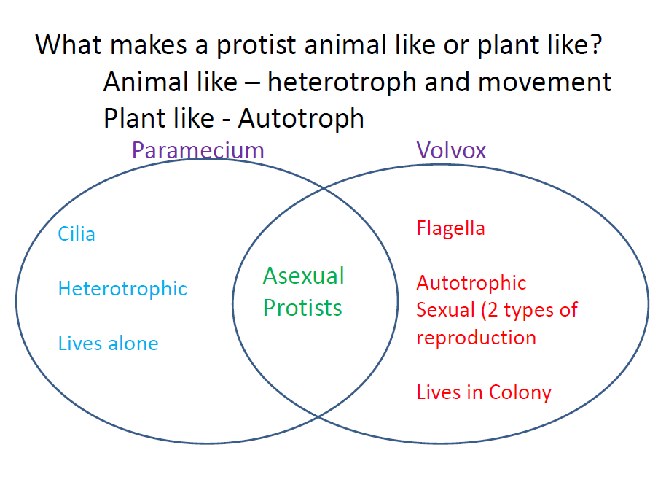

Slide 4
Protist Video Clips
https://www.youtube.com/watch?feature=player_embedded&v=oddMUHIj0wI Protist video
https://www.youtube.com/watch?v=sn3MTYNe8mM how a paramecium eats https://www.youtube.com/watch?v=fh_yjLppNAg paramecium https://www.youtube.com/watch?v=W6rnhiMxtKU amoeba feeds https://www.youtube.com/watch?v=YGmpcJeFfuw amoeba eating https://www.youtube.com/watch?v=fI7nEWUjk3A euglena movement https://www.youtube.com/watch?v=4MlR3dKfXmc euglena eye spot https://www.youtube.com/watch?v=He9FSeGRi3A volvox

