Slide 1
Wind and Wind Patterns Chapter 2.2 Guided Notes

Slide 2
What is Weather?
Weather is the condition of Earth’s atmosphere at a particular time and place.
What is Wind?
Wind is air moving across the surface of the Earth. It can move horizontally or parallel to the ground.
Bill Nye- Wind

Slide 3
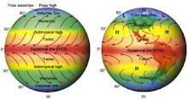
What causes wind?
Uneven heating of the Earths surface causes air pressure to differ from place to place.
This difference in pressure sets air in motion. Air moves from places of higher air pressure to areas of lower air pressure. This is wind!

Slide 4
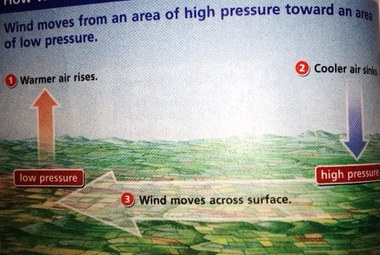
How Wind Forms

Slide 5
How Wind Forms
Sunlight strongly heats an area of the ground. The ground heats the air. The warm air rises, and an area of low pressure forms.
Sunlight heats an area of ground less strongly. The cooler, dense air sinks slowly, and an area of high pressure forms.
Air moves as wind across the surface, from higher towards lower pressure.

Slide 6
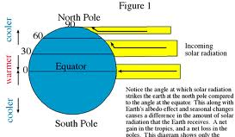
Why does the Sun heat the Earth unevenly?
Since the Earth is round, the suns energy does not evenly reach and heat the Earth.
Sunlight is concentrated near the equator because it strikes it directly.
Sunlight is more spread out near the poles because it strikes at a lower angle.

Slide 7
Think of a flashlight…

Slide 8
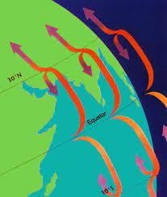
The Earth is heated unevenly, so what?
Uneven heating between the equator and the poles causes global winds.
Since the Earth is round, the sun’s energy doesn’t evenly reach and heat the Earth.
Sunlight is concentrated near the equator because it strikes it directly. Warm air rises, producing low pressure.

Slide 9
The Earth is heated unevenly, so what?
Sunlight is more spread out near the poles because it strikes at a lower angle.
Because less sunlight reaches here, the air is cooler and denser.
The sinking dense air produces high pressure that sets global winds in motion.

Slide 10
How does Earth’s rotation effect wind?
If Earth didn’t rotate, global winds would flow directly from the poles to the equators.
But Earth’s rotation changes the direction of the wind. This is called the Coriolis Effect.
Global winds curve as Earth turns beneath them.
Winds in the Northern Hemisphere curve to the right.
Winds in the Southern Hemisphere curve to the left.
The Coriolis Effect is only noticeable for winds traveling long distances.

Slide 11
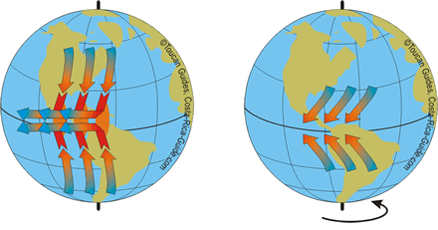
Coriolis Effect
http://www.youtube.com/watch?v=7TjOy56-x8Q

Slide 12
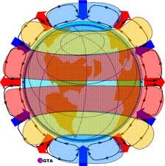
What are Global Winds?
The distances winds travel varies.
Some winds die out quickly and travel short distances.
The winds that travel thousands of miles and are able to last for weeks are called Global Winds.
The Coriolis Effect prevents the winds from flowing directly from the poles to the equator, causing them to move in three routes, called global wind belts.
http://www.youtube.com/watch?v=jLiDZOqFqD8

Slide 13
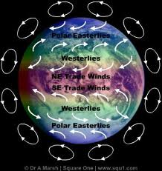
Circulation Cells
A giant loop of moving air.
Includes a wind belt and the calm regions that border it.
http://www.youtube.com/watch?v=6lqWE74ve5U

Slide 14
Wind Belts
Dense air sinks in high pressure areas and it flows out to areas of low pressure.
This pattern produces three global wind belts in each hemisphere.
Because of the Coriolis Effect, winds curve toward the east or west. Some global wind belts are named for the direction from which they blow.

Slide 15
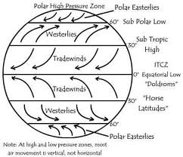
Wind Belts
Trade Winds-
Blow from the east
Move from the horse latitudes toward equator
Strong and steady but die as they reach equator
Westerlies
Blow from the west
Move from the horse latitudes toward the poles
Bring storms across much of US
Easterlies
Blow from the east
Move from polar regions toward mid-latitudes
Stormy weather often occurs when cold air of easterlies meets warm air of westerlies

Slide 16
Calm Regions
Earth’s rotation and uneven heating of its surface cause a pattern of wind belts separated by calm regions.
Each calm region is a zone of either high or low pressure.
Winds are light and they often change direction.
Doldrums- low pressure zone near equator.
Warm air rises to top of troposphere
Air spreads out towards poles
Rising, moist air produces clouds and heavy rains
Heavy evaporation from warm ocean water fuels tropical storms
Horse latitudes- high pressure zones 30⁰N and 30⁰S of equator
Warm air traveling from equator cools and sinks here
Weather tends to be clear and dry

Slide 17
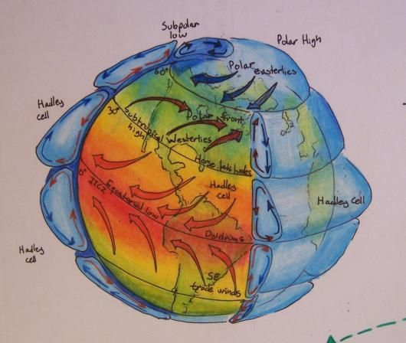
Model of the Earth with all wind belts, convection cells, and calm regions.

Slide 18
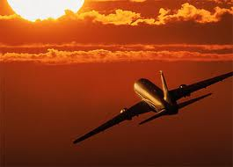
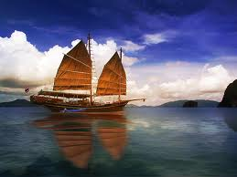
Wind and Travel
Sailors have sought out and relied on global wind belts for centuries, using the trade winds to move from Europe to N America, and the westerlies to return home.
Air travel time can be lengthened or shortened by jet streams.

Slide 19
Not all winds travel along Earth’s surface!
Jet Streams are long-distance winds that travel in the upper troposphere.
They travel long distances from west to east.
They travel at 124 miles per hour! Yep, that’s fast.
Form due to uneven heating of Earths surface, like global winds.
Flow in a wavy pattern around the Earth.
Each Hemisphere has two.
Affect air travel times. Usually flow 6-9 miles above Earth’s surface- airplane travel times can be lengthened or shortened by jet streams.

Slide 20
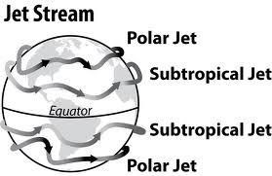

Slide 21
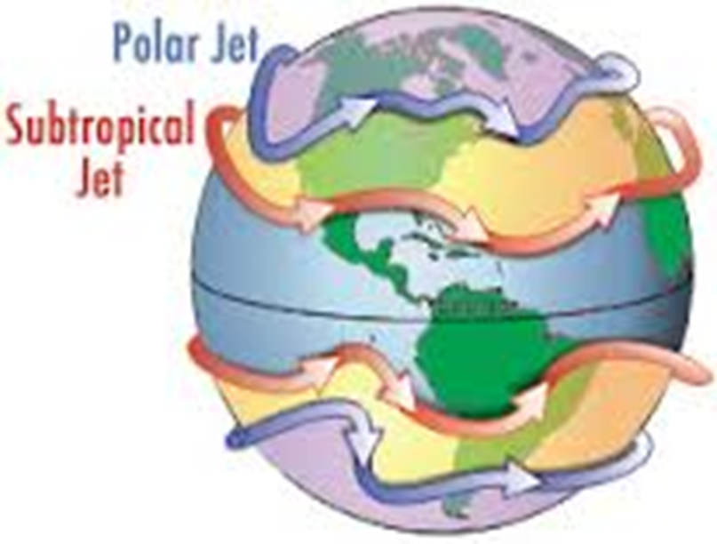
Types of Jet Streams
Polar Jet Streams- flow closer to the poles.
Pull cold air toward Equator and warm air up toward poles.
Strong storms form along its loop.
Have strong influence on N America’s weather
Subtropical jet streams- flow closer to equator.
http://www.youtube.com/watch?v=CgMWwx7Cll4

Slide 22
The Gulf Stream
Warm Atlantic Ocean current traveling north
Influences climate of N America’s east coast and Europe’s west coast.
The warm Gulf Stream waters from FL combine with the cold winds from the north. This brings dense fog and immense heat transfer causing intense storms.

Slide 23
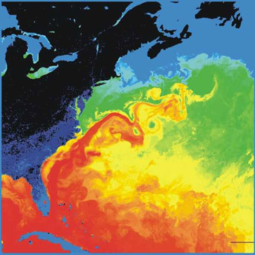
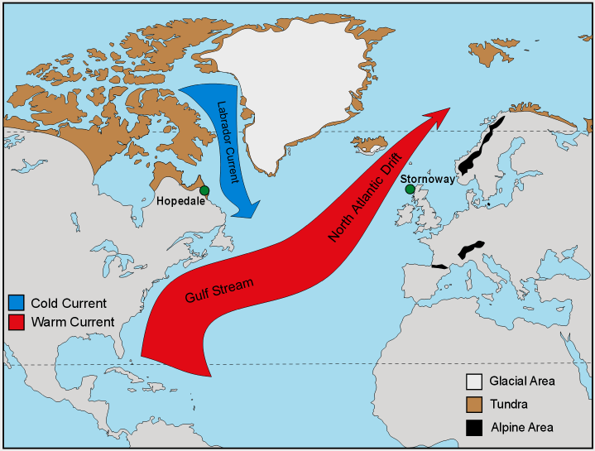
The Gulf Stream
http://www.youtube.com/watch?v=m-zO8L66uyg

Slide 24
Local Winds
Change daily within a regular pattern and blow within small areas.
Sea breezes and land breezes occur near shorelines.
Sea breezes- During the day, land heats up faster than water. Air over the land rises and denser ocean air (high pressure) moves toward the area of low pressure.
Land breezes- During the night, land cools faster than water. Warm air rises over the ocean and cooler air flows in, producing a land breeze.

Slide 25
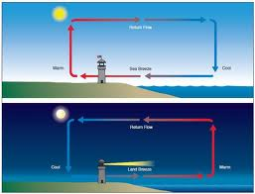
SEA BREEZE
LAND BREEZE
http://www.youtube.com/watch?v=ZQV72Yzmjyc

Slide 26
Valley/Mountain Breezes
Mountain slopes heat up and cool faster than the valleys below them.
During the day, valley breezes flow up mountains- mountain breezes
During the night, mountain breezes flow down into valleys- valley breezes

Slide 27
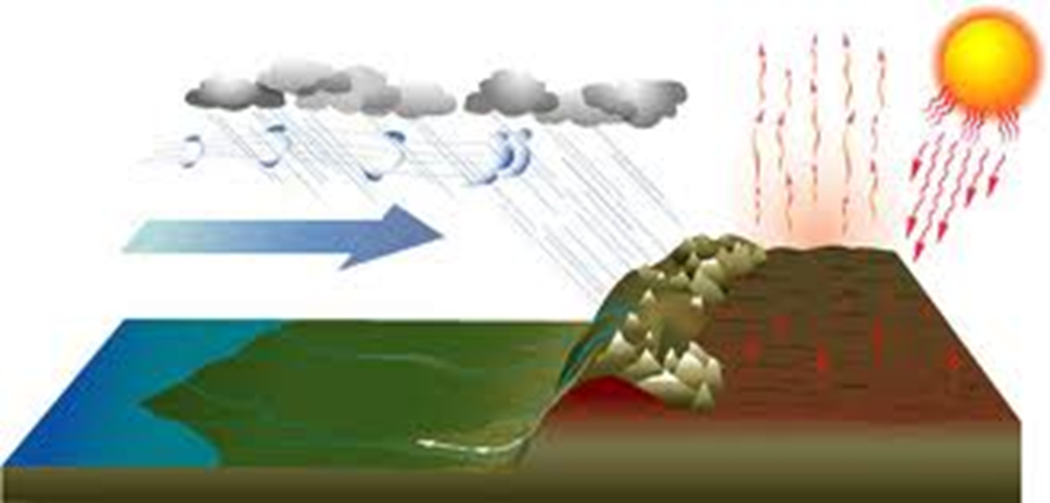
Monsoons
http://www.youtube.com/watch?v=MNJ9A3x4rAY
Winds that change direction with the seasons.
Caused by different heating and cooling rates of land and sea.
Winter monsoons occur in areas where land becomes much cooler than the sea. High pressure builds over the land and cool, dry winds blow out to the sea.
Summer monsoons occur when land becomes warmer than the sea. Moist wind blows from the sea over the land, bringing heavy rains.
Most extreme monsoons occur in S and SE Asia. Farmers depend on this rain to grow their crops!

Slide 28
