Slide 1
Integumentary System
The body’s shield

Slide 2
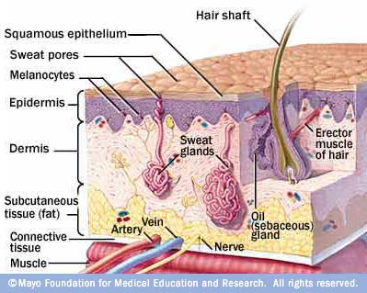
Integumentary System

Slide 3
Skin performs important functions
Integumentary system- the skin, hair, and nails.
Functions of the skin:
Repels water
Guards against infection
Helps maintain homeostasis
Senses the environment

Slide 4
Layers of Skin
The skin is composed of two layers: the dermis and epidermis.
Epidermis- the outer layer
Cells contain protein fibers that give the skin tough, protective qualities
These cells are formed in lowest layer of epidermis but move slowly upward as cells below them form. The oldest cells on top rub off.
The surface cells are dead but form a waterproof layer that is 30 cells thick.

Slide 5
Layers of Skin
Dermis- the inner layer
Made of tissue that is strong and elastic
Able to change shape instead of tear when it moves against surfaces
Rich in blood vessels with healthy O₂ supply
The dermis contains sweat glands, oil glands, hair, nails, and sensory receptors
Fatty layer lies beneath the dermis to protect against extreme temperature and stores energy

Slide 6
Sweat and Oil Glands
Your skin has pores: tiny opening that allow important substances to pass through the skin.
Sweat glands: help control body temperature
Present almost everywhere on the body.
Secrete sweat (99% water) when you become too warm. Sweat evaporates, releasing heat.
Oil glands help protect the skin by keeping it moist
Present almost everywhere on the body.
Secrete oil that moistens skin and hair to keep it from becoming dry and adds flexibility to provide part of the skin’s waterproofing.

Slide 7
Hair and Nails
Hair and nails are made of dead cells.
Hair protects it from the sun and keeps heat in during cold weather to keep you warm.
Nails protect the tips of the fingers and toes from injury.

Slide 8
Sensory Receptors
Receptors that are a part of the nervous system are located in your skin and function to protect your body.
These receptors are sensitive to pain, pressure, temperature, touch, and vibration.

Slide 9
Skin Growth
As a person grows, skin grows.
Most of the skin’s growth occurs in the epidermis.
Every 2 to 4 weeks your skin is entirely new.
Gross fact: a percentage of household dust is actually your skin cells!

Slide 10
Injuries and Healing: Burns
Skin can repair itself from simple injuries.
Burns can be serious.
1st degree: skin becomes red and heals within a day or two. Only the epidermis is effected. PAINFUL.
2nd degree: Extends into the dermis. Can include blisters. PAINFUL.
3rd degree: Extends through the dermis and below. PAINLESS. Why? NERVES ARE DAMAGED!
Burns are assessed by surface area: how much of the body is burned. 15% is considered life threatening. Why? DEHYDRATION and infection!

Slide 11
Injuries and Healing: Burns
Burns can be caused by heat, electricity, chemicals, or radiation.
Sunburns: minor 1st degree burns (radiation!)
Repeated exposure can cause skin cancer
Severe cold can damage skin as well
Frostbite can range from damage like a mild cut to severe damage leading to amputation.

