Slide 1
Section 1.4
Human activities affect the atmosphere.

Slide 2
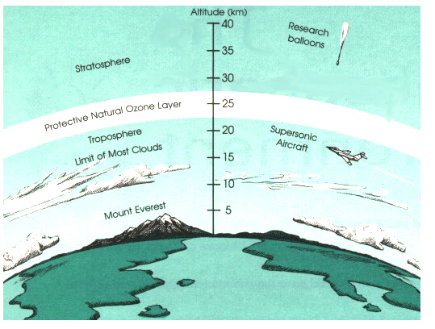
The Ozone Layer: A Review
90% of all ozone is in the stratosphere
10% of all ozone is in the troposphere
Ozone is extremely important because it is the only gas that absorbs UV radiation from the sun and protects the Earth from its damaging effects.

Slide 3
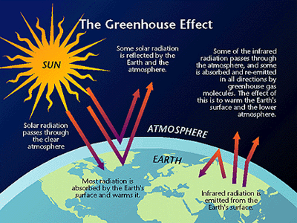
The Greenhouse Effect: A Review

Slide 4
Human activities cause air pollution, increase greenhouse gases, and produce chemicals that destroy the ozone layer.
(W/U) Think about when someone burns toast at home. Can you smell it sometimes, even if you’re in a different room? Why?
Everyone that breathes in that air breathes in the smoke from the burnt toast. Is this air pollution?
When we are outdoors, the wind blows air pollution just like the fan does at home.
Can you smell, see or feel ALL types of air pollution?
MOST pollution leaves the air or becomes thin enough to be harmless over time.

Slide 5
Types of Pollution
Gas
Carbon monoxide, methane, ozone, sulfur oxides, nitrogen oxides
Some are naturally occurring in our atmosphere
They are only considered pollutants when they are likely to cause harm
Ex: Ozone is helpful in the stratosphere, harmful in the troposphere. Why?
Particles (or Particulates)
Easier to see than gas pollutants
Smoke (contains particulates), dirt, pollen, dust, salt from the ocean

Slide 6
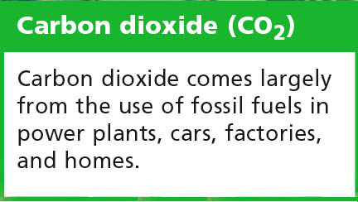
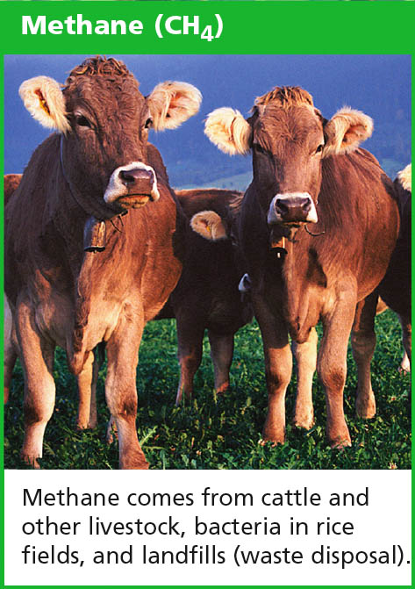
Sources of Pollution
Natural Sources
• dust, pollen, soil, salt
• volcanoes and forest fires:
gases and particles
Human Activities
• fossil fuels: gases and particles
• unburned fuels: smog
• manufacturing: gases and particles
• tractors/construction equipment:
dust and soil
• farming: fertilizers and pesticides

Slide 7
Fossil Fuels
Fossil Fuels are formed from the remains of prehistoric animals and plants
Most air pollution in cities and suburbs comes from burning of fossil fuels (oil, gasoline, coal)
Why?
This can result in smog, the combination of smoke and fog, a newer type of air pollution
Sunlight causes fumes from fossil fuels to react chemically. The reaction forms new pollutants (like ozone) and creates smog.

Slide 8
Effects of Pollution
Health problems
Irritation to eyes, nose, throat, and lungs
Exercising in polluted air is dangerous. Why?
Most dangerous for children, elderly, and people with asthma
Damage to plants, buildings, and other outdoor objects
Particulates being absorbed into the atmosphere can affect the weather
Rain clears the air but brings the pollutants to the ground, lakes, and oceans
Harmful Gases in the air
An increase in Carbon Dioxide keeps heat in the atmosphere from escaping into space.
Decreases the amount of ozone in the Stratosphere.
Increases Greenhouse Gases

Slide 9
Sources of Greenhouse Gases
Plant growth, forest fires, volcanoes, and other natural processes affect the amounts of carbon dioxide and other greenhouse gases in the atmosphere.
The amounts of greenhouse gases affect temperatures on Earth.
Temperatures affect plant growth and other processes that affect greenhouse gases.
Sound familiar? What is this an example of?
Most greenhouse gases occur naturally and have helped keep temperatures at a suitable range for life on Earth.
Human activities are producing greenhouse gases faster than they can be removed from the atmosphere.

Slide 10
Global Warming
The air contains about 30% more carbon dioxide than it did in the mid-1700’s.
The level of CO2 is now increasing about 0.4% per year.
Temperatures have risen in recent decades.
It is estimated that the average global temp will rise another 1.4-5.8 degrees C by 2100.
This will affect food, water, and other resources.

Slide 11
Destroying the ozone layer
Ozone is a pollutant at our level, but it is a protectant in the stratosphere.
Certain chemicals disrupt the cycle in the ozone layer. Cholorofluorocarbons (CFC’s) are in cooling systems, spray cans, and styrofoam.
These chemicals break down in the stratosphere and release ozone-destroying chemicals.

Slide 12
Reducing Greenhouse Gases
New technologies: new ways of heating and cooling buildings, transportation, making products using less energy.
Reduces air pollution
Safer for the environment
Energy alternatives to fossil fuels
What can we do every day that can reduce greenhouse gases and prevent global warming?

Slide 13
The Ozone Over Time

Slide 14
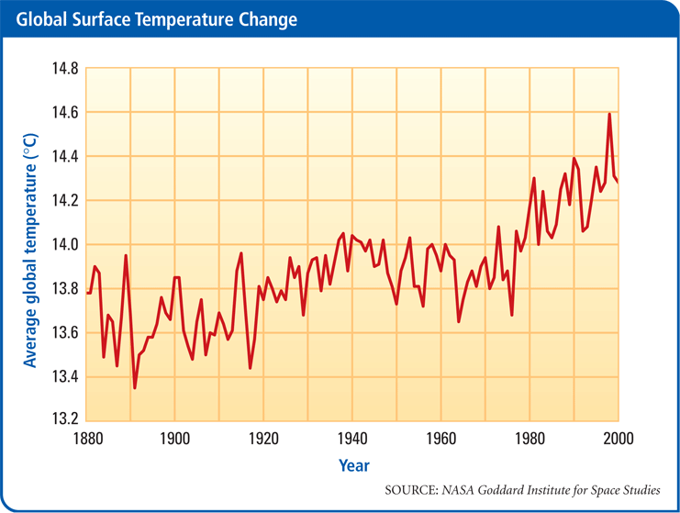
Temperature Change Over Time

