Slide 1
The Urinary System
Chapter 2.3

Slide 2
Systems That Remove Waste
URINARY- removes liquid waste
RESPIRATORY- removes water vapor and gas waste
DIGESTIVE- removes solid waste
INTEGUMENTARY (SKIN)- removes liquid waste through sweat

Slide 3
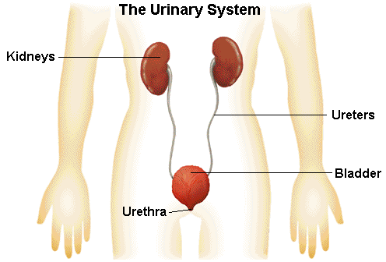
Urinary System
FUNCTION- to filter liquid waste from the blood!
MAJOR ORGANS:
Kidneys
Ureters
Bladder
Urethra

Slide 4
Path of the Urinary System
KIDNEYS- Two organs that filter the blood
URETERS- Tubes that carry waste from the kidneys to the bladder
BLADDER- Sac that stores liquid waste (urine) and has a wall of smooth muscle
URETHRA- Tube that carries liquid waste outside of the body

Slide 5
Function of the Kidneys
Kidneys are about the size of your fist and filter all of the blood in your body many times a day.
Each kidney has about one million looping tubes called NEPHRONS that regulate the makeup of the blood.
Inside of the nephron is a structure called the GLOMERULUS that filters fluid from the blood. This liquid is now URINE, and is sent out of the kidney and into the ureters.
Kidneys also regulate the amount of water in the body to maintain HOMEOSTASIS.

Slide 6
