Slide 1
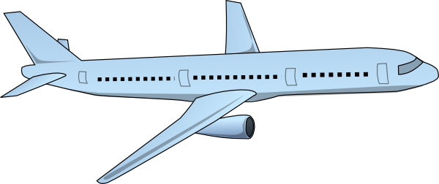
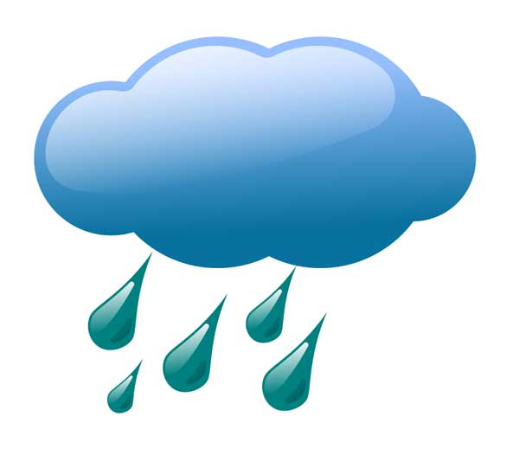
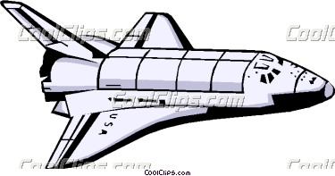
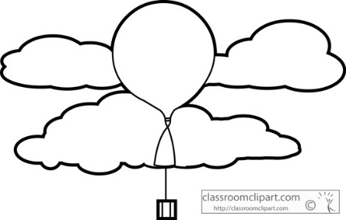
Jet
Satellite
Aurora Borealis
Weather
Meteors burn up
Jet Stream
Space Shuttle
EARTH
Weather Balloon
Density
Density
Density
Stratosphere
Density
Density
Mesosphere
Life
Troposphere
O₃ O₃ O₃
Ozone
Thermosphere
Exosphere

