Slide 1
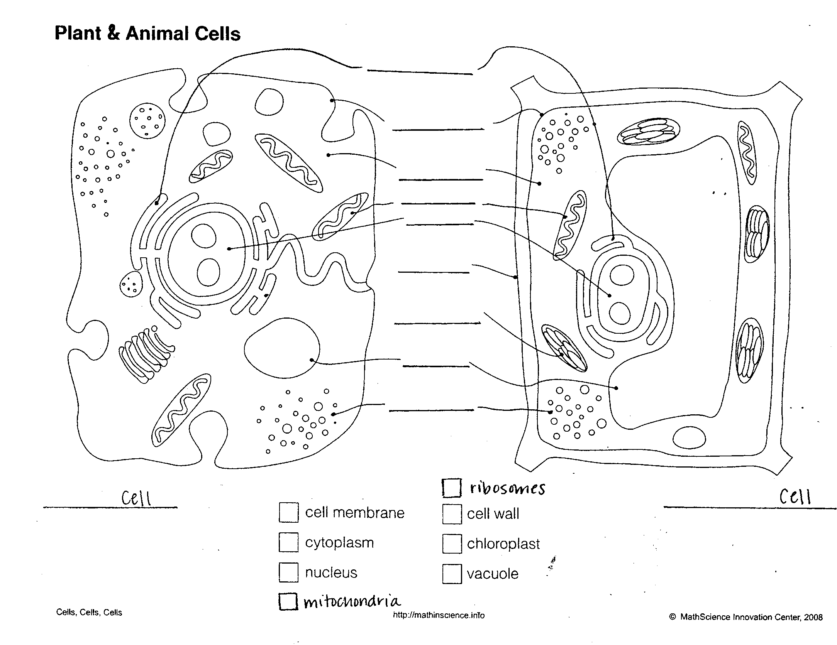
_________
[ ] lysosomes
[ ] endoplasmic reticulum

