Slide 1
Setting up Your Student Accounts in NCEDCloud so they can access Powerschool, Schoolnet, and Canvas

Slide 2
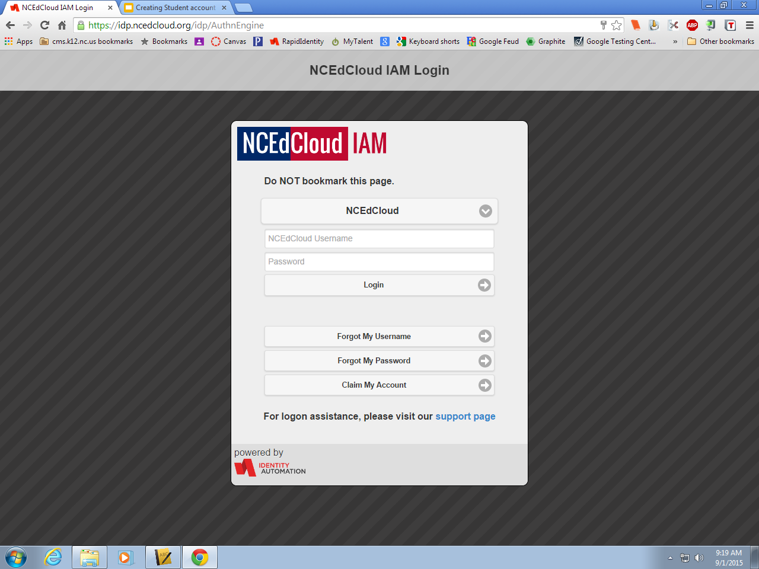

Slide 3
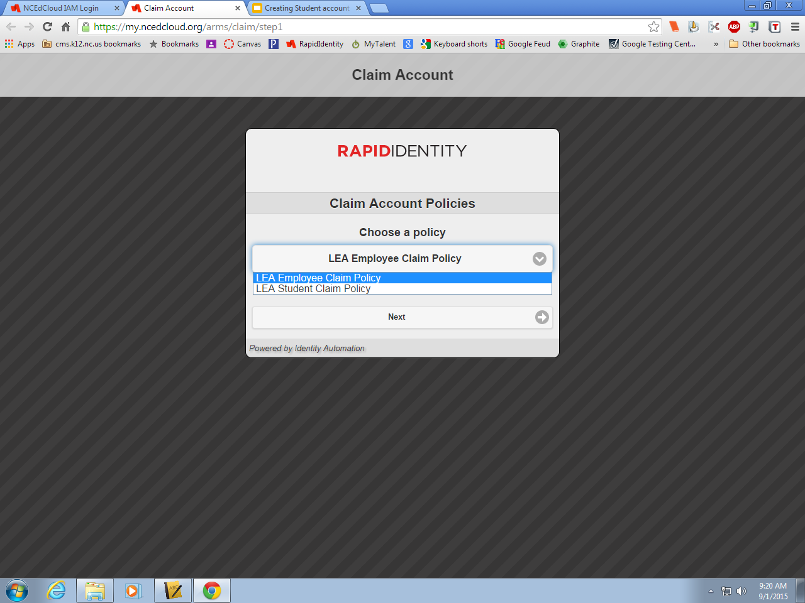

Slide 4
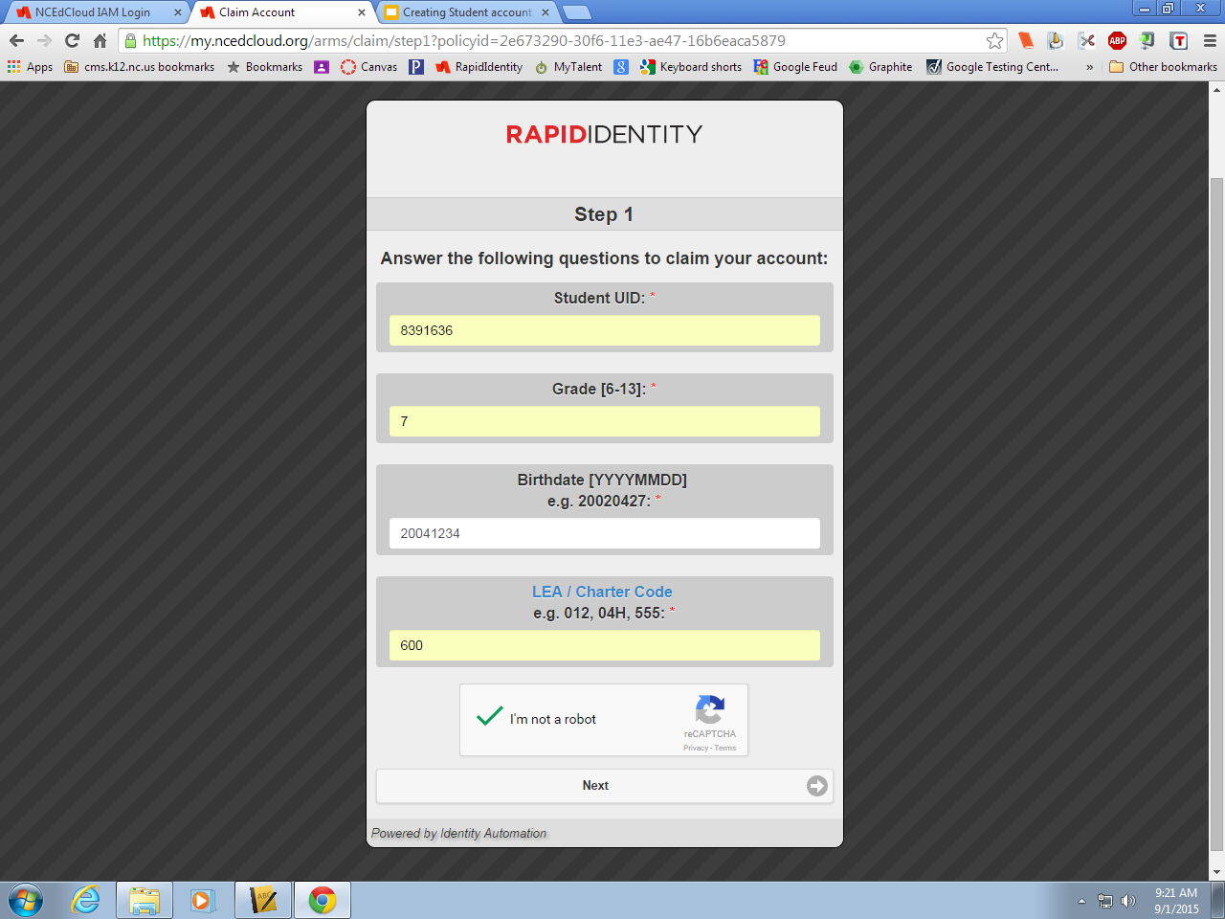

Slide 5
Password Page Setup
1.Have the students click on the eye to allow you to see their password as they set it up.
2. Make sure you
tell the students not
click next you will do
that for them.
Password should be: Sb781204!
3.Pleaseremind student to write password down.
4.Once you have verified the student's password select next
Last Name Initial in Lowercase
Birthday
Exclamation Mark
YYMMDD
First Name Initial in Caps

Slide 6
The Question Screen
-Students have to answer 5 questions
-Have them answer the word “None” for all of them and then hit next.
This should complete the claiming account process. Please remind students to

