Slide 1
Genetics and Heredity Test Trivia

Slide 2
Each topic has 5 questions. You will have 2 minutes to answer each question with your group, assign a point value for the question, and turn in your answer to me.
If you do not turn in your answer by the end of the song to me, your answer will not count.
You can only use each point value once (1,3,5,7,9)
There will be a final question worth up to 20 points

Slide 3
Round 1
Punnett Squares

Slide 4
Round 1 Question 1
If a homozygous dominant male rabbit and a homozygous recessive female rabbit are crossed, where brown fur is dominant to white fur, how many of the offspring will be heterozygous?

Slide 5
Round 1 Question 2
If two heterozygous parents were crossed, where brown eyes are dominant to blue eyes, what are the phenotype(s) of the offspring (include the percent of offspring having the phenotype(s)?

Slide 6
Round 1 Question 3
If a homozygous dominant male is crossed with a heterozygous female, where being tall is dominant to being short, what are the genotype(s) of the offspring (include the percent for the genotype(s)?

Slide 7
Round 1 Question 4
Traits you receive from your birth parents are called:

Slide 8
Round 1 Question 5
If an offspring has the genotype Bb and another has the genotype of BB where brown eyes is dominant to blue eyes, what color eyes will the offspring have and why?

Slide 9
Round 1 Answers
1. 100%
2. Brown eyes (75%) and blue eyes (25%)
3. BB (50%) and Bb (50%)
4. Inherited
5. Brown eyes because they both carry the dominant allele

Slide 10
Round 2
Meiosis

Slide 11
Round 2 Question 1
Cells that contain half the usual number of chromosomes are called:

Slide 12
Round 2 Question 2
Meiosis occurs in what type of cells?

Slide 13
Round 2 Question 3
During meiosis, how many divisions does a cell go through? What are those divisions called?

Slide 14
Round 2 Question 4
What is a diploid or 2n cell?

Slide 15
Round 2 Question 5
Polar bodies are the 1n cells produced by the female that dissolve away. About how many of the 1n cells become polar bodies?

Slide 16
Round 2 Answers
1. Gametes, 1n, haploid, egg or sperm
2. Reproductive
3. 2: Meiosis I and Meiosis II
4. Cell that contains the full number of chromosomes (46 or 23 pairs)
5. 3

Slide 17
Round 3
Pedigree Charts

Slide 18
Round 3 Question 1
In a pedigree, a male is indicated by a ________________ and a female is indicated by a ____________________.

Slide 19
Round 3 Question 2
In a pedigree, how are individuals carrying traits indicated?

Slide 20
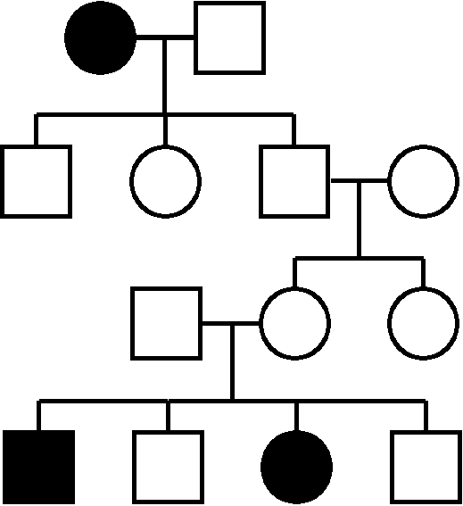
Round 3 Question 3
Having freckles is dominant and not having freckles is recessive. How many people have freckles in this pedigree?

Slide 21
Round 3 Question 4
Having freckles in dominant and not having freckles is recessive. What percent of people have freckles in the 4th generation?

Slide 22
Round 3 Question 5
If a male has freckles, which is the dominant trait, could he be heterozygous, homozygous dominant or homozygous recessive? If he can be more than one, list all he can be.

Slide 23
Round 3 Answers
1. Square; circle
2. A blackened shape
3. 3
4. 50%
5. Heterozygous and homozygous dominant

Slide 24
Round 4
Mitosis

Slide 25
Round 4 Question 1
List the sequence of steps in the cell cycle.

Slide 26
Round 4 Question 2
In a chromosome, the ball of protein that holds the copies together is called a:

Slide 27
Round 4 Question 3
Mitosis produces __________________ _______________________ daughter _________________.

Slide 28
Round 4 Question 4
What is the purpose of cell division?

Slide 29
Round 4 Question 5
When cell division is complete, how much cytoplasm and how many chromosomes will a daughter cell have compared to the parent cell?

Slide 30
Round 4 answers
1. Interphase, prophase, metaphase, anaphase, telophase, cytokinesis
2. Centromere
3. Two identical daughter cells
4. Repair, develop and grow
5. Half the cytoplasm and the same number of chromosomes

Slide 31
Final Question

Slide 32
Final Question
On a separate piece of paper, list the steps of the cell cycle and list one thing that happens during that phase (IPMATC)

