Slide 1
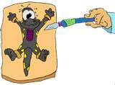
Frog Dissection
Bailey Middle School

Slide 2
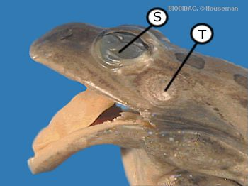
External Anatomy
Verify that your frog has both a nictitating membrane (S) and a tympanic membrane (T). The nictitating membrane is a transparent lower eyelid that cleans and protects the eye. The tympanic membrane is an eardrum that receives sound waves.
Verify that only the back feet of your frog are webbed.
Predict the sex of your frog by observing the thumb pads on its front feet. Males’ thumb pads are bigger at the base than a females.

Slide 3
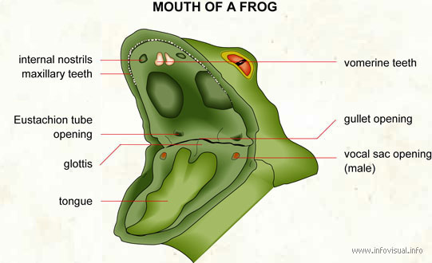
External Anatomy
Verify that there are no teeth on the lower jaw. Find the vomerine teeth on the upper jaw. They are used for hold food or prey.
Look for openings in the mouth that lead to Eustachian tubes, which connect to the middle ear and equalize pressure.
Find the glottis. The glottis is the opening from the mouth to the respiratory system.
Now see if you can find the tongue. Compare and contrast your tongue and the frogs tongue.

Slide 4
Interesting Facts
Unlike humans, frogs don’t store fat next to the
skin. Frogs store winter fat in fat bodies found
inside the body cavity. If your frog was collected
late in the year, the body cavity might be full of
yellow-orange fat bodies.

Slide 5
Before we proceed
While dissecting, be respectful of your lab partners and of the specimen you are about to explore, observe and learn from.
Take extra care with your dissection tools. Your scissors are your most important tool, but be sure to handle them carefully and always double check before cutting.
If you have any questions, please ask.

Slide 6
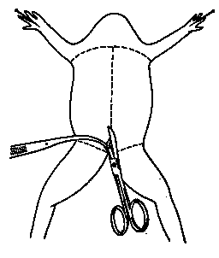
Incision 1: Skin First
Place your frog on its back and pin it to the dissecting tray.
Lift the frog’s skin with forceps between the rear legs.
Make a small cut through the lifted skin with the scalpel. Take care to cut only the skin.
Use the scissors to continue the incision up to the midline all the way through the frog’s skin.
Stop cutting when your scissors reach the frog’s skin.

Slide 7
Incision 2: Skin Horizontal
Use the scissors to make sideways incisions in the skin.
The first incisions are made between the front legs.
The next incisions are made just above the rear legs
Be careful to only cut through the skin, not the muscle.

Slide 8
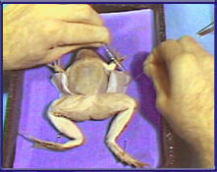
Incision 3: Separate Skin
Pick up the flap of skin with the forceps.
Use a scalpel to help separate the skin from the muscle layer below.
After you've opened the flaps of skin, pin them to the dissection tray.

Slide 9
Incision 4: First Muscle Incision
Repeat the incisions, this time through the abdominal muscle. You will find it easier to begin the vertical incision by lifting the muscle layer with the forceps. Do this between the rear legs of the frog.
Make a small cut with the scalpel.
Using the scissors, continue the incision up the midline to a point just below the front legs.
Be careful that you don't cut too deeply. The muscle is thin. It is easy to damage the organs underneath.

Slide 10
Incision 5: Chest Bone
Cut through the chest bones. When you reach the point just below the front legs, turn the scissors blades sideways, so that you only cut through the bones in the chest. Be careful that you don't cut too deeply.
This should prevent damage to the heart or other internal organs.
When the scissors reach a point just below the frog's neck, you have cut far enough.

Slide 11
Incision 6: Muscle Horizontal
Make the horizontal incisions. Just as you did with the skin, make a sideways incision in the muscle with the scalpel.
Make the first incision between the front legs.
The next incision is just above the rear legs.
Again, be careful that you don't cut too deeply.

Slide 12
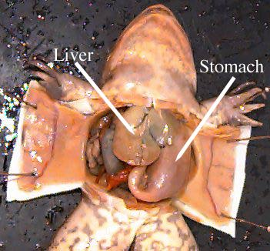
Incision 7: Muscle Separate
Separate the muscle flaps from the organs below. Pull back and hold the muscle flaps with the forceps.
Use the scalpel to separate the muscle from the organ tissue.
Pin the muscle flaps back far enough to allow easy access to the internal organs.

Slide 13
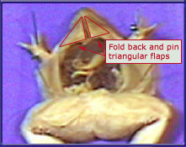
Incision 8: Triangular Flaps
Pin the triangular flaps of the skin and muscle to the pan. Pick up the triangular flap of muscle that is just above the legs with the forceps.
Use the scalpel, if needed, to help separate the muscle flap from the tissue underneath.
Pin the flaps back far enough to allow access to the body cavity.

Slide 14
Organs 1: Introduction
We are now ready to explore the frog's anatomy. To make our exploration easier, we will look at the organs in four different layers, beginning with the liver and heart layer.
As we get deeper into the frog's anatomy, we will reveal new layers.
We'll even explore the differences between male and female reproductive anatomy.
Notes:
The slides are just for exploration not actual removal of organs. Make sure the students are just probing around. Do not allow them to remove organs at this juncture.

Slide 15
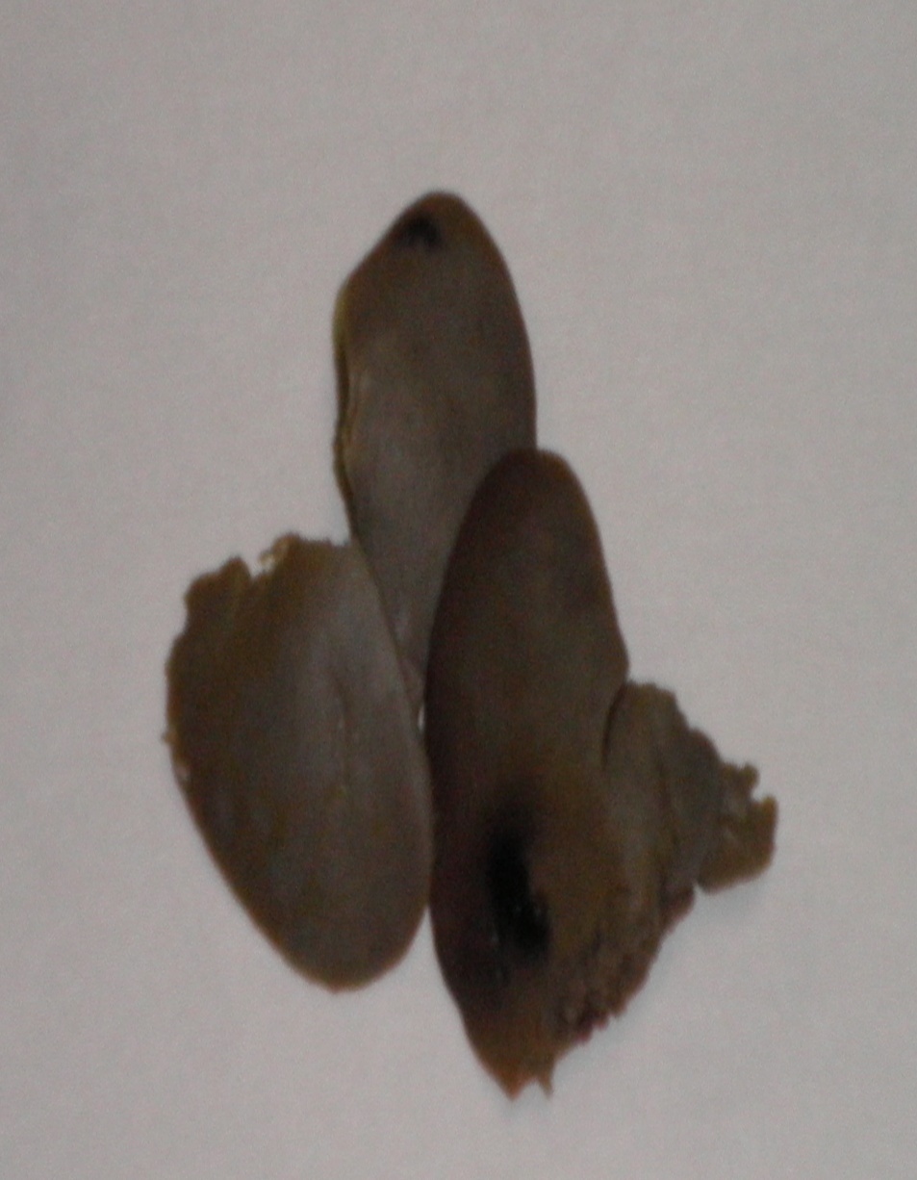
Organs 2: Liver
When we pull back the muscles and skin, the first organs we can see are the liver and heart.
The liver is a large, brownish colored organ covering most of the body cavity.

Slide 16
Organs 3: Heart
You should also be able to see the heart in Layer 1.
It is a small triangular shaped organ between the front legs, just above the liver.
The frog’s heart has three chambers. The picture (right) shows only the lower chamber of the heart. Can you find all three chambers?
How many chambers do you have in your heart?

Slide 17
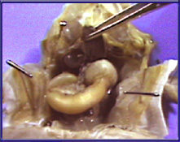
Organs 4: Layer 2
Reveal layer two. The heart and liver in layer one hide some of the organs below them.
Use the forceps and the probe to pick up the liver and reveal layer two.
Layer two includes the gall bladder, the stomach, and the small intestine.
Notes:
Student should be exploring.

Slide 18
Organs 5: Gall Bladder
Examine the gall bladder. Under the liver, we see a small, greenish sac. This is the gall bladder. You might also see it by separating the right and middle lobes of the liver.
The gall bladder can be hard to find.
Notes:
You might have the students remove the gall bladder as they might cut through it when they remove the liver. Again, the students are supposed to be exploring here, but it’s your choice if you want them to remove the gall bladder at this time. I have mixed emotions. I think I would want them to explore, then remove the organs and place them on the worksheet so I could determine what they retained during the exploration. Or you could have them remove it at slide 21. Your choice.

Slide 19
Organs 6: Stomach
Examine the stomach. The stomach looks like a sac on the frog's left side (on your right). It is a large firm organ.

Slide 20
Organs 7: Small Intestine
Examine the small intestine. The small intestine is a long, folded, tube like organ that is posterior the stomach.
It is similar in color to the stomach, but smaller in diameter.

Slide 21
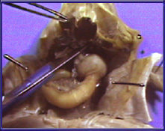
Organs 8: Layer 3
Reveal layer three. Remove the liver to see the organs in layer three.
The liver is easier to remove if you remove the gall bladder and heart at this time.
Place the organs in the appropriate circle on your dissection worksheet.

Slide 22
Organs 9: Lungs
In this layer, we will take a close look at the lungs and pancreas. The lungs are difficult to locate in a preserved frog.
They're at the anterior end of the body cavity on either side of the heart.
Remove the lungs and place the organ in the appropriate circle on your dissection worksheet.

Slide 23
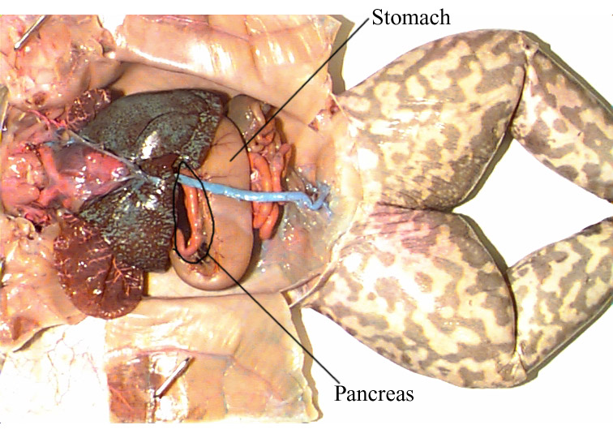
Organs 10: Pancreas
You can't see the pancreas without lifting the stomach and intestines with the forceps. The pancreas is a thin, yellowish ribbon.
The intestines are held in place by thin, transparent tissue called the mesentery.

Slide 24
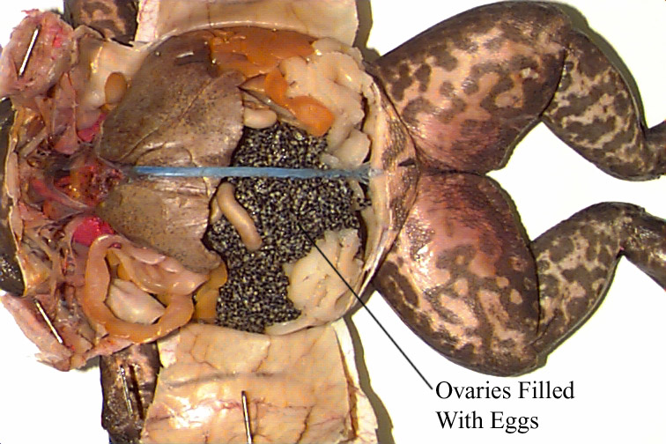
Female Frogs
If you have a female frog, you will need to remove the ovaries before you can see layer four.
Place the organs in the appropriate circle on your dissection worksheet.

Slide 25
Organs 11: Layer 4
To see layer four, you need to remove the stomach, small intestine, large intestine, and pancreas.
Place the organs in the appropriate circle on your dissection worksheet.
In layer four, we'll look at the procedures required to see the different organs in both male and female frogs.

Slide 26
Organs 12: Spleen
Examine the spleen. Locate the spleen in the male frog. It is a small, round reddish organ.
It is a little more difficult to find the spleen in a female frog

Slide 27
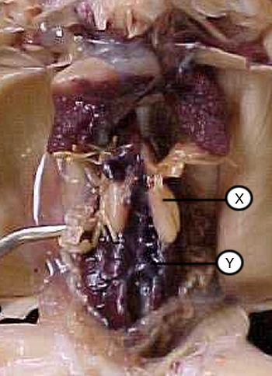
Organs 12: Male Kidneys
The kidneys are elongated, brownish colored organs found in the lower part of the frog's abdomen.
The kidneys (Y) are situated on each side of the middle of the frog just underneath the testes (X).
Female kidneys are located in the same place but can only been seen after removal of the ovaries and oviducts.
Remove the organ and place in the appropriate circle on your dissection worksheet.

Slide 28
Organs 13: Frog Testes
Locate the testes in the male frog. The testes are tan colored, bean shaped organs near the anterior end of each kidney.
Remove the testes and place the organs in the appropriate circle on your dissection worksheet.

