Slide 1
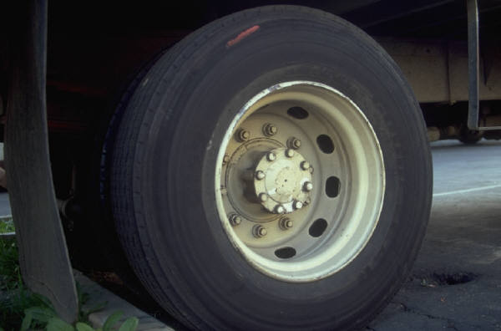
The 6 Simple Machines
Inclined Plane
Screw
Wedge
Pulley
Wheel and Axle
Lever

Slide 2
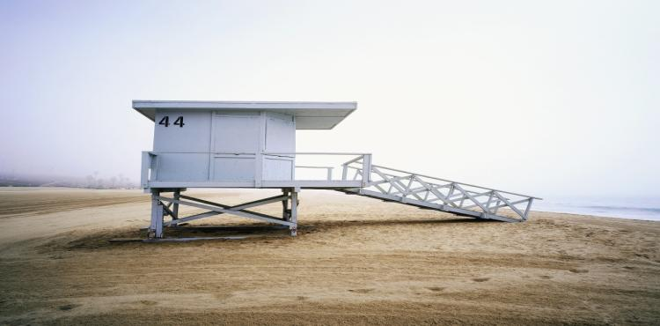


Inclined Plane

Slide 3
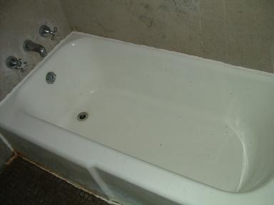
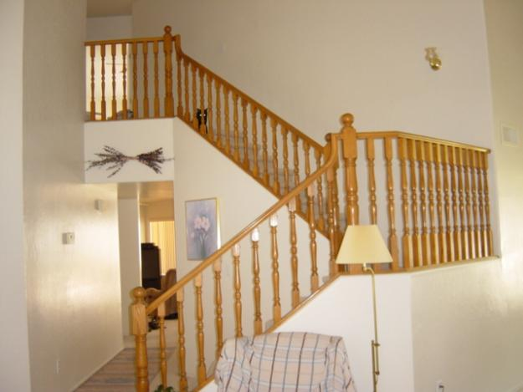
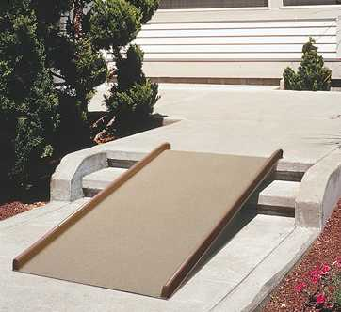
Inclined Planes
An inclined plane is a flat surface that is higher on one end
An inclined plane doesn’t move.
Inclined planes make the work of moving things easier
Notes:
A sloping surface, such as a ramp. An inclined plane can be used to alter the effort and distance involved in doing work, such as lifting loads. The trade-off is that an object must be moved a longer distance than if it was lifted straight up, but less force is needed.
You can use this machine to move an object to a lower or higher place. Inclined planes make the work of moving things easier. You would need less energy and force to move objects with an inclined plane.

Slide 4
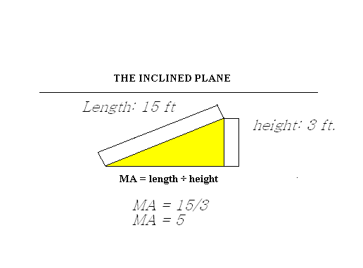
Inclined Plane -
Mechanical Advantage
The mechanical advantage of an inclined plane is equal to the length of the slope divided by the height of the inclined plane.
While the inclined plane produces a mechanical advantage, it does so by increasing the distance through which the force must move.

Slide 5

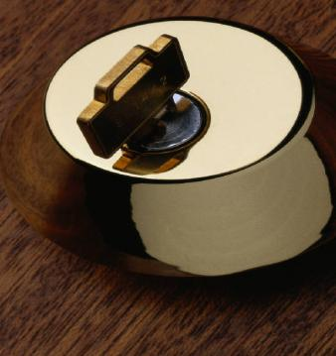

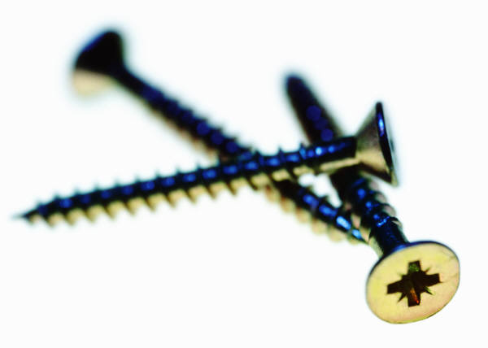
Screw

Slide 6
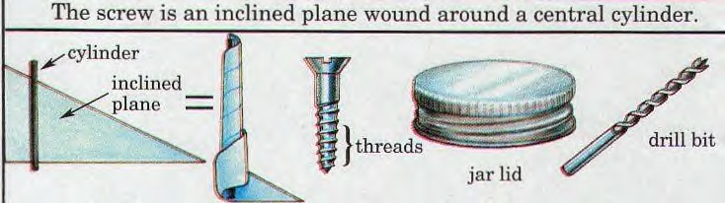
Screw
The mechanical advantage of an screw can be calculated by dividing the circumference by the pitch of the screw.
Pitch equals 1/ number of turns per inch.

Slide 7

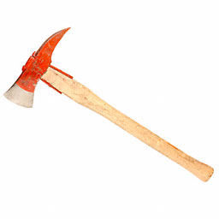
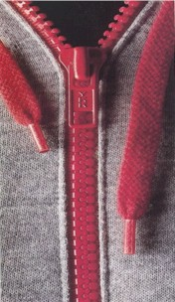
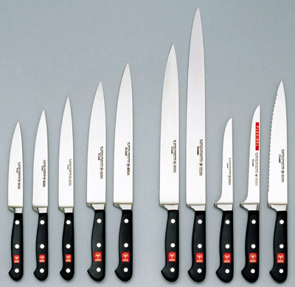


Wedges
Two inclined planes joined back to back.
Wedges are used to split things.
Wedges move where inclined planes don’t.

Slide 8
Wedge – Mechanical Advantage
The mechanical advantage of a wedge can be found by dividing the length of either slope (S) by the thickness (T) of the big end.
S
As an example, assume that the length of the slope is 10 inches and the thickness is 4 inches. The mechanical advantage is equal to 10/4 or 2 1/2. As with the inclined plane, the mechanical advantage gained by using a wedge requires a corresponding increase in distance.
T

Slide 9
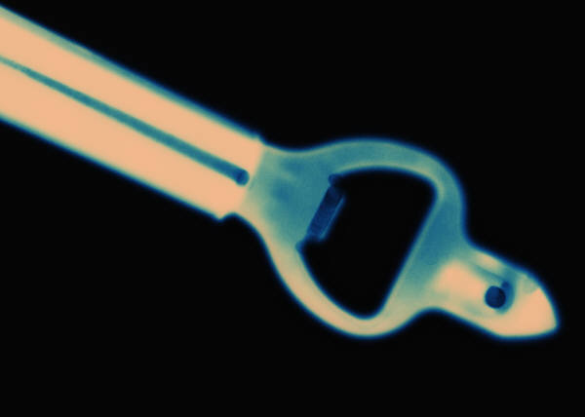
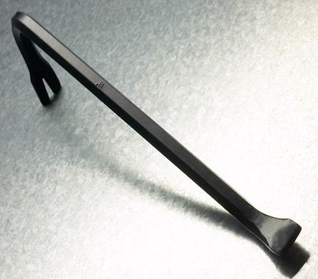
A lever uses force to move something

Slide 10
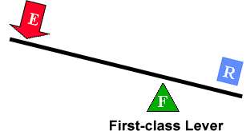
Fulcrum is between EF (effort) and RF (load)
Effort moves farther than Resistance.
Multiplies EF and changes its direction
The mechanical advantage of a lever is the ratio of the length of the lever on the applied force side of the fulcrum to the length of the lever on the resistance force side of the fulcrum.
First Class Lever

Slide 11

First Class Lever
.
  Common examples of first-class levers include crowbars, scissors, pliers, tin snips and seesaws.

Slide 12
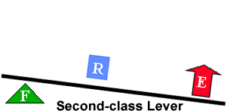
RF (load) is between fulcrum and EF
Effort moves farther than Resistance.
Multiplies EF, but does not change its direction
The mechanical advantage of a lever is the ratio of the distance from the applied force to the fulcrum to the distance from the resistance force to the fulcrum.
Second Class Lever

Slide 13

Second Class Lever
Examples of second-class levers include nut crackers, wheel barrows, doors, and bottle openers.

Slide 14
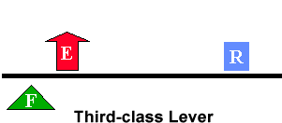
EF is between fulcrum and RF (load)
Does not multiply force
Resistance moves farther than Effort.
Multiplies the distance the effort force travels
The mechanical advantage of a lever is the ratio of the distance from the applied force to the fulcrum to the distance of the resistance force to the fulcrum
Third Class Lever

Slide 15
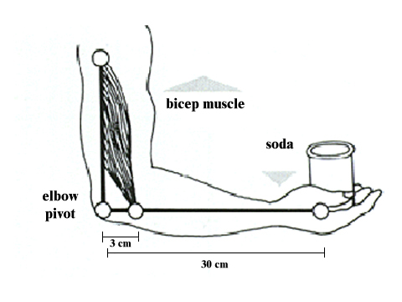

Third Class Lever
Examples of third-class levers include tweezers, arm hammers, and shovels.

Slide 16

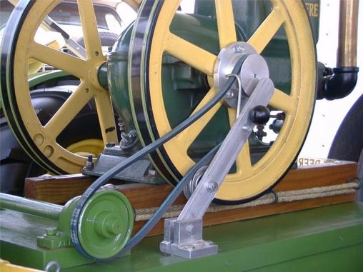

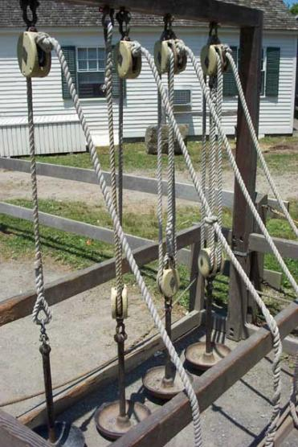
Pulleys
Pulley are wheels and axles with a groove around the outside
A pulley needs a rope, chain or belt around the groove to make it do work

Slide 17
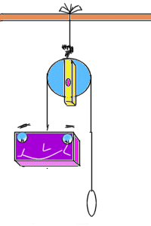
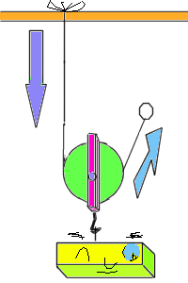
Diagrams of Pulleys
Fixed pulley:
A fixed pulley changes the direction of a force; however, it does not create a mechanical advantage.
Movable Pulley:
The mechanical advantage of a moveable pulley is equal to the number of ropes that support the moveable pulley.

Slide 18
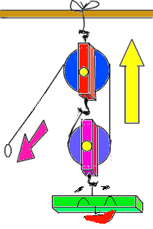
COMBINED PULLEY
The effort needed to lift the load is less than half the weight of the load.
The main disadvantage is it travels a very long distance.

Slide 19
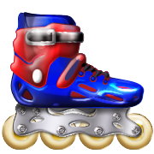
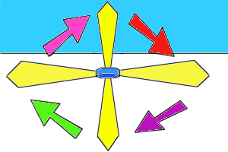

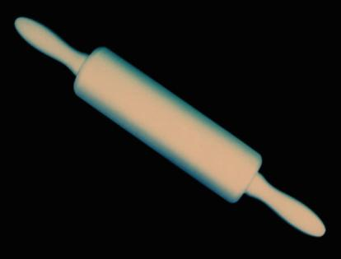

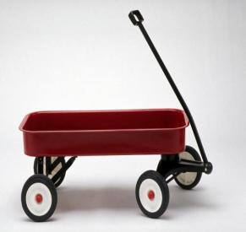
WHEEL AND AXLE
The axle is stuck rigidly to a large wheel. Fan blades are attached to the wheel. When the axel turns, the fan blades spin.

Slide 20
Wheel and Axle
The mechanical advantage of a wheel and axle is the ratio of the radius of the wheel to the radius of the axle.
In the wheel and axle illustrated above, the radius of the wheel is five times larger than the radius of the axle. Therefore, the mechanical advantage is 5:1 or 5.
The wheel and axle can also increase speed by applying the input force to the axle rather than a wheel. This increase is computed like mechanical advantage. This combination would increase the speed 5 times.
1
5

Slide 21

GEARS-Wheel and Axle
Each gear in a series reverses the direction of rotation of the previous gear. The smaller gear will always turn faster than the larger gear.

