Slide 1
Electric
Circuits

Slide 2
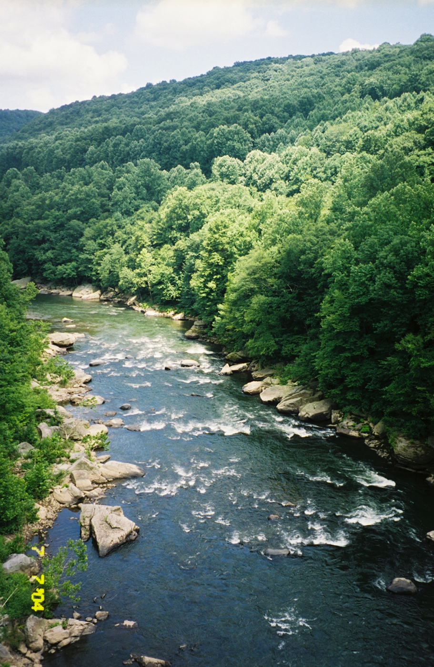
How you should be thinking about electric circuits:
Resistance: friction that impedes flow of current through the circuit (rocks in the river)

Slide 3

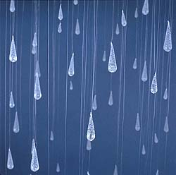
How you should be thinking about electric circuits:
Current: the actual “substance” that is flowing through the wires of the circuit (electrons!)

Slide 4
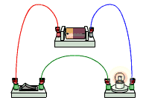
circuit diagram
Scientists usually draw electric circuits using symbols.
cell
lamp
switch
wires

Slide 5
What is the difference between open and closed circuits?

Slide 6
Circuit:
A closed-loop path of conduction through which an electric current flows

Slide 7
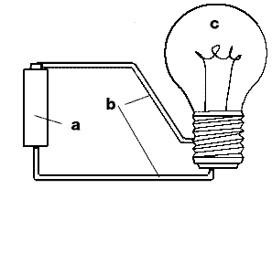
Open circuit:
An incomplete path that will not permit an electric current to flow

Slide 8
Closed circuit:
A complete path for electric current

Slide 9
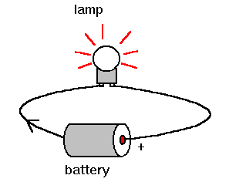
What kind of circuit is this?
Open circuit?
Closed circuit?
Notes:
closed

Slide 10
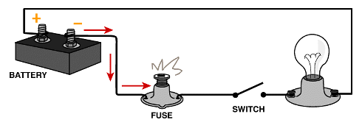
What kind of circuit is this?
Open circuit?
Closed circuit?
Notes:
Open- the switch is open!

Slide 11
How Do You Make Electricity Do What You Want?

Slide 12
Insulator: a substance through which electricity cannot flow readily
Examples…
wood plastic rubber
sulfur glass

Slide 13
Conductor: a material through which electrons can move easily
Examples…
brass aluminum copper
graphite water

Slide 14
Which of these items are conductors?
Notes:
Paper clips, the graphite of the pencil, pliers, penny, water in the sink, aluminum can

Slide 15

Which of these items are insulators?
Notes:
Rubber duck, clogs (shoes), glass, frisbee

Slide 16
What’s the Best Pathway for Electrons?

Slide 17
There are two main types of circuits:
Parallel
Series
and

Slide 18
Parallel circuits are circuits with more than one pathway through which electrons can flow.
Series circuits are circuits with only one pathway through which electrons can flow.

Slide 19
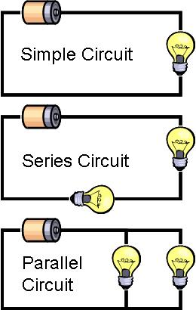
Series and Parallel Circuits

Slide 20
Comparison
 | Series Circuit | Parallel Circuit
Definition
Resistance
Examples
Only one path for current to flow
Multiple paths for current to flow
Total resistance increases
Total resistance stays same
Holiday lights
-Household Current

Slide 21
Adding Resistors to Series:
  Current in the circuit will go DOWN (lights will dim)
  If you remove a light bulb or one burns out—all go out!

Slide 22
Removing a Light Bulb:
If you remove a light bulb or one burns out, the others stay on because the circuit is still closed.

Slide 23
What type of circuit is shown here?
Flashlight
Parallel?
Series?
Notes:
series

Slide 24
What type of circuit is shown here?
Parallel?
Series?
Notes:
series

Slide 25
What type of circuit is shown here?
Home lighting
Parallel?
Series?
Notes:
parallel

Slide 26
What type of circuit is shown here?
Holiday lights
Parallel?
Series?
Notes:
series

Slide 27
What type of circuit is shown here?
Car headlights
Parallel?
Series?
Notes:
parallel

Slide 28
Series
Duracell
Duracell
Open or closed circuit?
Notes:
open

Slide 29
Series
Duracell
Duracell
Open or closed circuit?
Notes:
closed

Slide 30
Series
Duracell
Duracell
Open or closed circuit?
Notes:
open

Slide 31
Series
Duracell
Duracell
Open or closed circuit?
Notes:
closed

Slide 32
Series
Duracell
Duracell
Open or closed circuit?
Notes:
open

Slide 33
Series
Duracell
Duracell
Open or closed circuit?
Notes:
Open (missing a bulb)

Slide 34
Parallel

Slide 35
Parallel
Duracell
Duracell
Notes:
Open because the switch is open

Slide 36
Parallel
Duracell
Duracell
Notes:
Closed- all lights are lit

Slide 37
Parallel
Duracell
Duracell

Slide 38
Parallel
Duracell
Duracell
Two complete circuits ☺

Slide 39
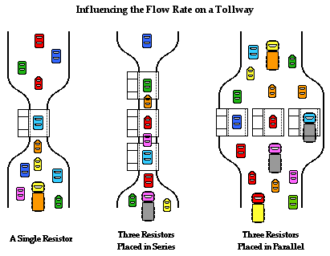
Toll Road—Circuit Analogy

Slide 40
Toll Booth Explanation
Adding toll booths in series increases resistance and slows the current flow.
Adding toll booths in parallel lowers resistance and increases the current flow.

