Slide 1
The Cell Cycle
Chapter 3.2

Slide 2
The Cell Cycle
The cell cycle is the normal sequence of development and division of a cell.
The cell cycle consists of two main parts:
Interphase- the cell carries out its functions
Cell division- consists of mitosis and cytokinesis
ALL CELLS DIVIDE BUT ONLY EUKARYOTES UNDERGO MITOSIS!
As a result of cell division, the original (parent) cell separates into two genetically identical daughter cells.

Slide 3
The Cell Cycle

Slide 4
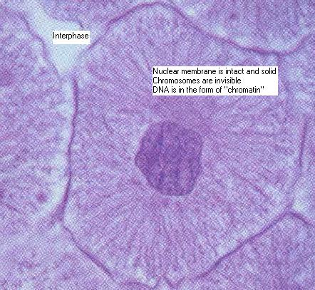
INTERPHASE
THE PART OF THE CELL CYCLE WHERE THE CELL IS NOT DIVIDING.
The cell grows about twice its original size.
It carries out normal activities(cellular transport, cellular respiration).
Changes that occur are in preparation for cell division. DNA is exactly duplicated so that after cell division occurs each new cell gets a complete set of DNA.

Slide 5
MITOSIS
Mitosis is the part of the cell cycle where the nucleus divides.
Remember the DNA is in the nucleus!
Prokaryotes DO NOT undergo mitosis because they have no nucleus.
The function of mitosis is to move the DNA and other material in the parent cell into position for cell division.

Slide 6
Steps of Mitosis
PROPHASE- chromosomes form
METAPHASE- chromosomes line up
ANAPHASE- chromosomes separate
TELOPHASE- nuclei form

Slide 7
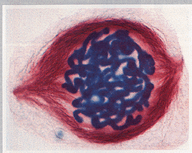
PROPHASE
CHROMOSOMES FORM
DNA in the nucleus condenses and becomes visible (under a microscope).
Each chromosome consists of two chromatids held together by a centromere.
The membrane around the nucleus disappears.

Slide 8
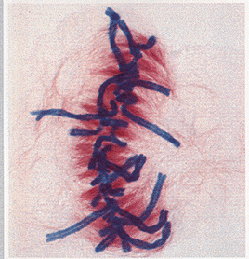
METAPHASE
CHROMOSOMES LINE UP
Chromosomes line up in the middles of the cell, “along the equator”.

Slide 9
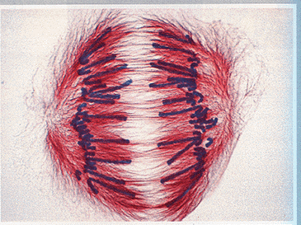
ANAPHASE
CHROMOSOMES SEPARATE
Chromatids split, resulting in two separate identical chromosomes.
These chromosomes are pulled onto separate sides of the cell.

Slide 10
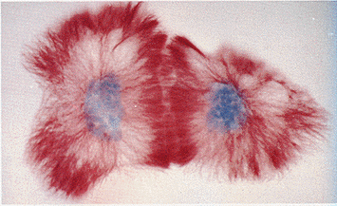
TELOPHASE
NUCLEI FORM
New nuclear membrane forms around each group of chromosomes.
Chromosomes return to their threadlike form.

Slide 11
CYTOKINESIS
Cytokinesis is the final stage of the cell cycle.
It is the division of the parent cell’s cytoplasm.
Cytokinesis occurs immediately after mitosis.
Once complete, the two daughter cells are completely separated, each surrounded by its own cell membrane. They are genetically identical to their parent cell, but smaller.

