Slide 1
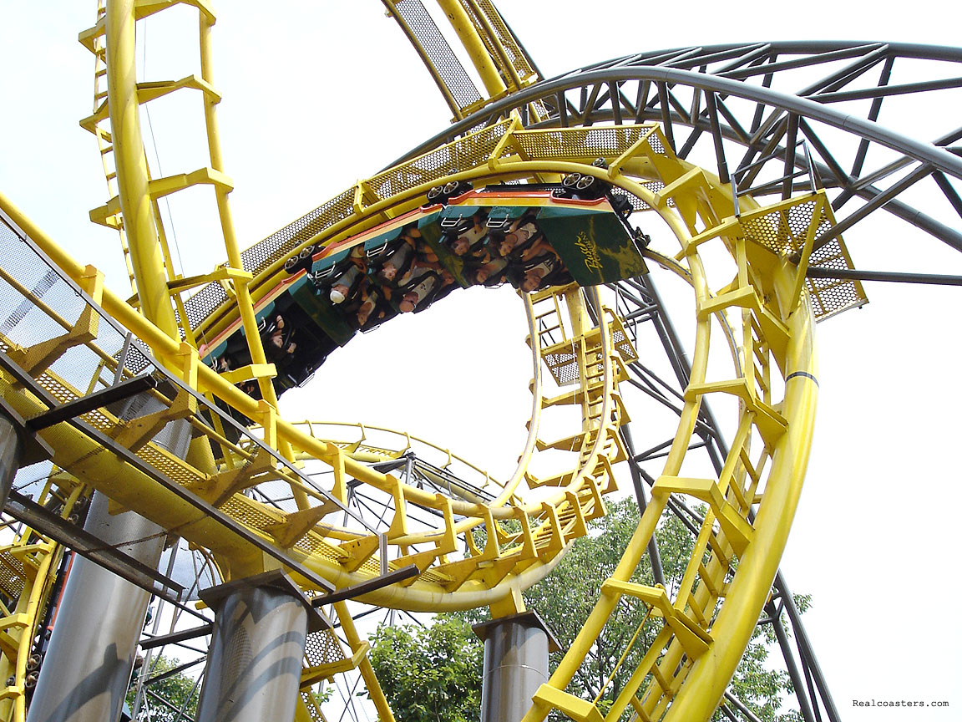
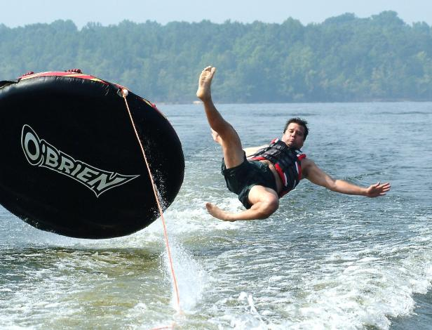
Potential and Kinetic Energy

Slide 2
How is all energy divided?
All Energy
Potential
Energy
Kinetic
Energy
Gravitation
Potential
Energy
Elastic
Potential
Energy
Chemical
Potential
Energy

Slide 3
What is Potential Energy?
Energy that is stored and waiting to be used later

Slide 4
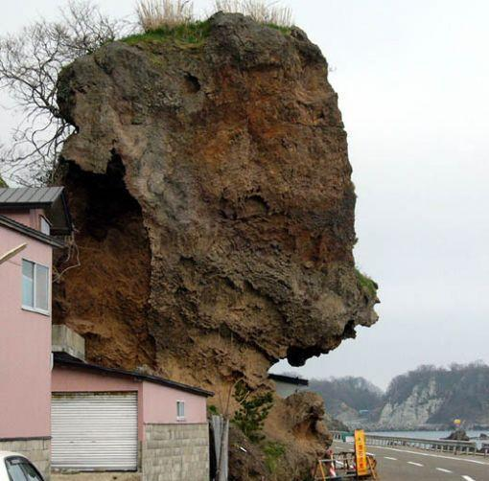
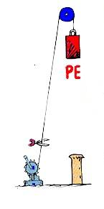
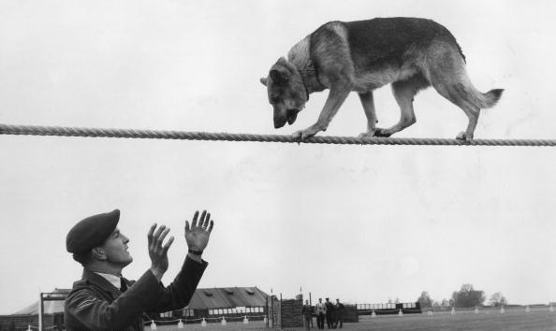
What is Gravitational Potential Energy?
Potential energy due to an object’s position
P.E. = mass x
height x gravity
Don’t look down, Rover!
Good boy!

Slide 5
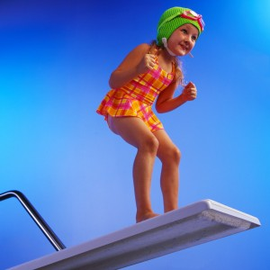
Calculate GPE!
What is the GPE of a girl who has a mass of 40 kg and is standing on the edge of a diving board that is 5 m above the water?
GPE=mgh

Slide 6
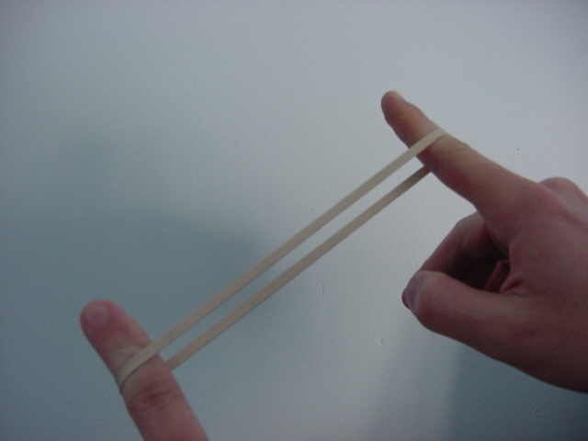
What is Elastic Potential Energy?
Potential energy due to compression or expansion of an elastic object.
Notice the ball compressing
and expanding
Notes:
Or a compressed spring

Slide 7
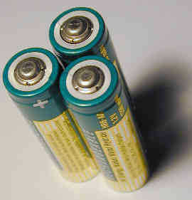
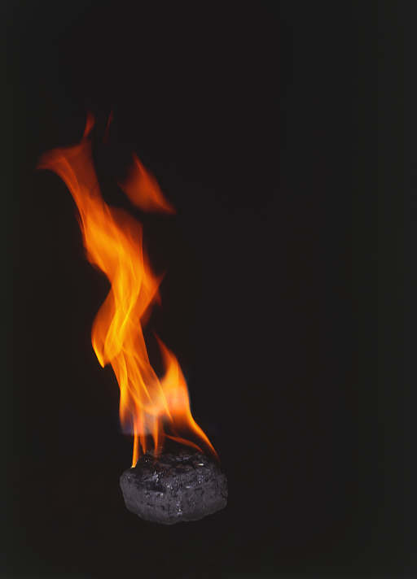
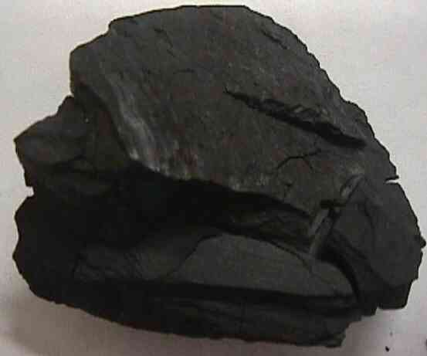
What is Chemical Potential Energy?
Potential energy stored within the chemical bonds of an object

Slide 8
How Much Potential Energy?
Depends on height above the Earth and weight.
The higher it is, the more PE it has
The heavier it is, the more PE it has

Slide 9
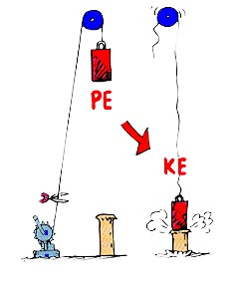
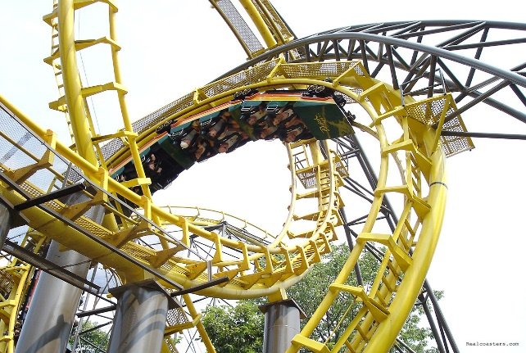
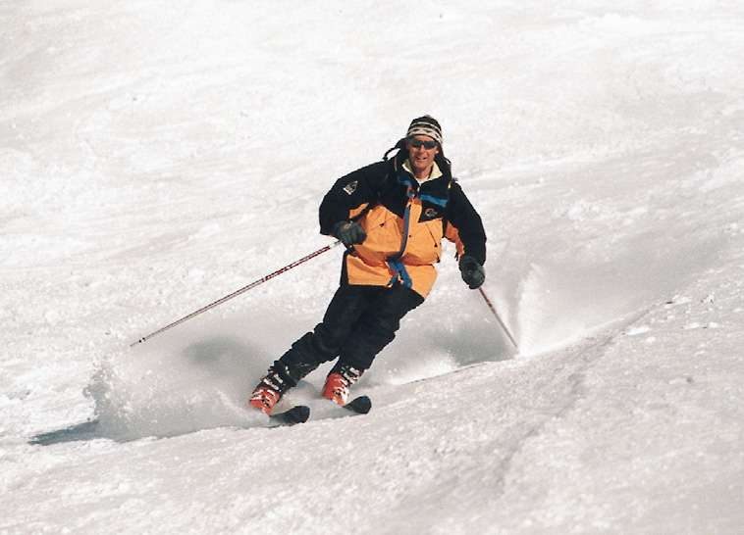
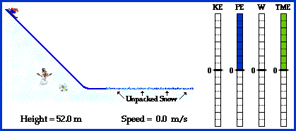
What is Kinetic Energy?
Energy an object has due to its motion
K.E. = .5(mass x speed²)

Slide 10
How Much Kinetic Energy?
The faster an object moves, the more kinetic energy it has.

Slide 11
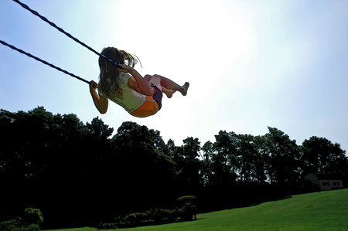
Calculate KE!
What is the kinetic energy of a girl who has a mass of 40 kg and a velocity of 3 m/s?
KE=1/2mv²

Slide 12
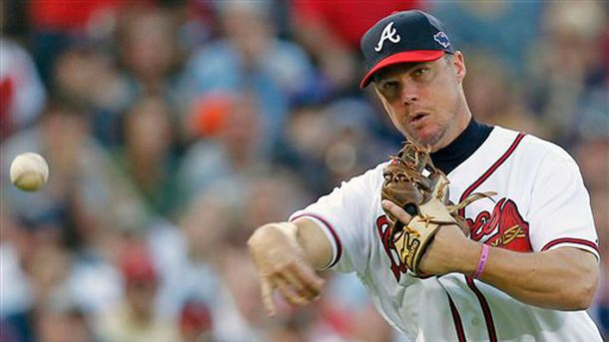
Mechanical Energy
Energy possessed by an object due to its motion or position (the objects combined potential and kinetic energy)
ME=PE+KE
Notes:
A thrown baseball has mechanical energy as a result of both its motion(kinetic energy) and its position above the ground (gravitational potential energy)

Slide 13
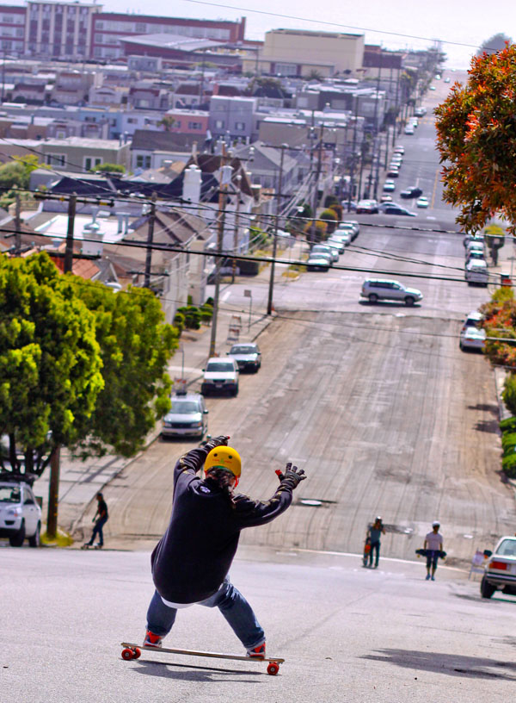
Calculate!
A skateboarder has a PE of 200 joules due to his position at the top of a hill and a kinetic energy of
100 joules due to his
motion. What is his total
mechanical energy?

Slide 14
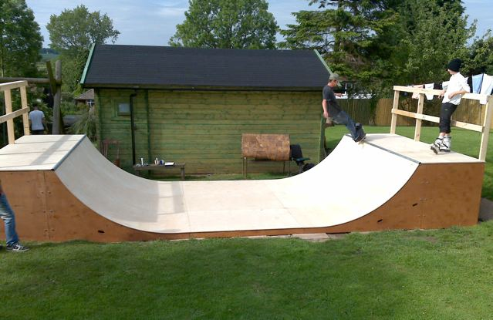
Law of Conservation of Energy
No matter how energy is transferred or transformed, all of the energy is still present somewhere in one form or another.

Slide 15
Skateboard Ramp
Top of skateboard ramp is 100% PE because gravity can pull him down but there is no velocity so no KE
Going down the ramp PE is decreasing because elevation is decreasing but KE is increasing because velocity increases 50/50
Bottom of ramp KE is 100% because gravity cannot pull him down more

Slide 16
Examples
When on a rollercoaster, when do you have the maximum PE? KE?
When you climb a waterslide, what type of energy are you gaining?
A lump of coal and a can of gasoline are examples of what type of energy?
Notes:
PE at the top of the hill KE at the bottom of the hill. Waterslide: PE. Coal and gasoline is chemical energy

Slide 17
More Examples
Which is an example of the conversion of PE to KE?
Catching a baseball
Recharging your cell phone battery
Stretching a rubber band
Coasting downhill on your bicycle
Notes:
D

