Slide 1
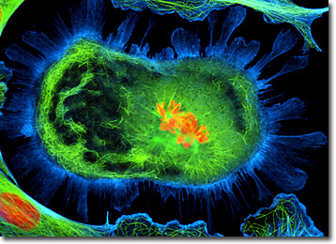
Cells Capture and Release Energy
Chapter 2 section 2

Slide 2
Cells need Energy
To stay alive, cells need a constant supply of energy. Animals get energy from food, while plant cells get energy from sunlight.
Chemical energy- energy stored in the _________ between atoms of every molecule
A major energy source for most cells is stored in a sugar molecule called ______________.
bonds
glucose

Slide 3
Why do we need energy?
When you need energy, cells release chemical energy from glucose.
When you move, muscle cells release chemical energy from glucose (by breaking bonds) to move your legs.
The more you move, the more glucose your muscle cells need. You eat food to restore the glucose supply in muscles. (Remember, glucose is sugar!)
Plants transform the energy in sunlight into the chemical energy in glucose in their chloroplasts.

Slide 4
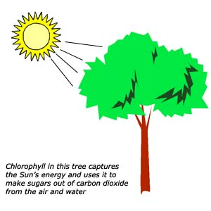
Photosynthesis— The process that plant cells use to change the energy from sunlight into nutrients for the plant.
The source of energy for all organisms ultimately comes from the Sun.
Takes place in the _________________ of plant cells.
Chloroplasts contain chlorophyll which traps the sunlight.
Chloroplast

Slide 5
How does photosynthesis work?
1. The starting materials :
___________ and ___________
2. The process:
Carbon dioxide and water enter the plant cell’s _______________. Meanwhile, __________________ is capturing energy from the sun.
3. The products:
Glucose and _________.
Carbon dioxide, water,
Energy from the sun
chloroplast
chlorophyll
Oxygen

Slide 6
Photosynthesis
Energy
Glucose
Chloroplast
Carbon Dioxide
Oxygen
Water
Materials In →
Products Out →

Slide 7
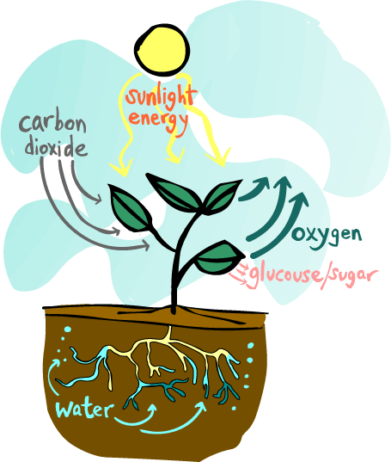
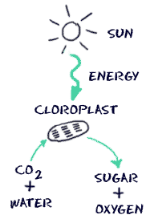
Photosynthesis

Slide 8
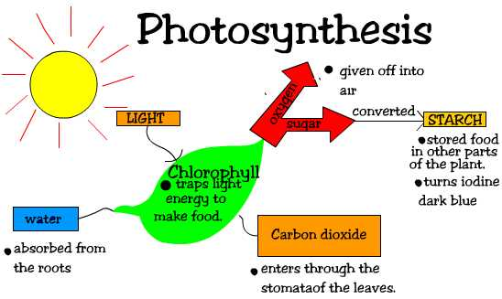

Slide 9
All Cells Release Energy
Glucose and other sugars are cell food. They are the power source for cell activities in almost all living things.
Chemical energy is stored in the _______ of sugars.
Cells release energy in two ways.
1. ___________ Respiration
2. __________________
bonds
Cellular
Fermentation

Slide 10
Cellular Respiration
Takes place in the __________________ of cells.
Starting materials:
___________ and ___________
The Process:
Glucose in the cytoplasm is broken down into smaller molecules.
These smaller molecules go into the mitochrondria along with oxygen and get broken down even further.
The products:
___________ & ____________& _____________
mitochrondria
Sugar (glucose)
Oxygen
Energy
Carbon dioxide
Water

Slide 11
Cellular Respiration
Water
Glucose
Mitochondria
Carbon Dioxide
Oxygen
Energy
Materials In →
Products Out →

Slide 12
What if your cells don’t have oxygen? Can cellular respiration occur?
NO!
_______________ is the process by which cells release energy without oxygen.
Two types : ____________ fermentation
______________ fermentation
Glucose breaks down in cytoplasm into smaller molecules which releases small amounts of energy. These smaller molecules do not enter mitochondria to get broken down any further.
Fermentation
alcoholic
lactic acid

Slide 13
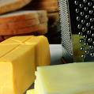
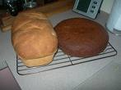
Fermentation in the food we eat
Yeast: a microorganism that uses fermentation to convert sugar into alcohol and CO2. The bubbles of CO2 cause it to rise. When the dough is baked, the alcohol evaporates, yeast is killed, and CO2 bubbles give the bread a light, spongy structure!

Slide 14
Cheeses and Yogurt
Lactic acid fermentation takes place
____________ convert sugar found in milk into lactic acid and it is used to make yogurt, cheese, and sourdough bread.
Gives it a slightly sour flavor.
Buildup of lactic acid causes the milk to partially solidify, producing the creamy texture of yogurt.
If it continues for a long time, the milk eventually turns into cheese!
Bacteria

